Slide 1



CanSat 2018 Preliminary Design Review (PDR)
Outline
Team Logo
Here
(If You Want)
Version 1.2
# 4128
TEAM CERVOS
CanSat 2018 PDR: #4128 Team CERVOS
1

Slide 2
Presentation Outline
Team Logo
Here
(If You Want)
Page No. | Contents | Presenter
5 - 17 | System Overview | Miray Özbay
18 - 27 | Sensor Subsystem Design | Burhan Kaplan
28 - 39 | Descent Control Design | Mustafa Eryılmaz
40 - 59 | Mechanical Subsystem Design | Ahmet Vehbi Genç
60 - 72 | Communication and Data Handling Subsystem Design | Alp Demirel
73 - 78 | Electrical Power Subsystem Design | Burhan Kaplan
79 - 83 | Flight Software Design | Kadir Serhat Altıntığ
84 - 96 | Ground Control System Design | Ramazan Kurban
97 - 108 | CanSat Integration and Testing | Berkay Küçükkılavuz
109 - 113 | Mission Operations & Analysis | Mustafa Anıl Yiğit
114 - 122 | Requirements Compliance | Mustafa Anıl Yiğit
123 - 132 | Management | Melisa İrem Uzun
Presenter: Burhan Kaplan
2

Slide 3
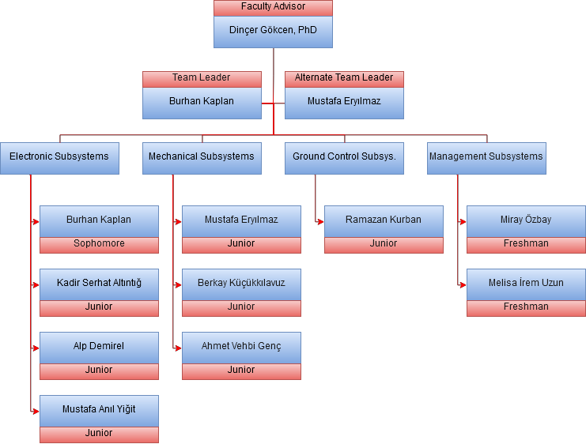
Team Organization
Team Logo
Here
(If You Want)
Presenter: Burhan Kaplan
2

Slide 4
Acronyms
Team Logo
Here
(If You Want)
Acronym | Meaning | Acronym | Meaning
CDH | Communication and Data Handling | PCB | Printed Circuit Board
DCS | Descent Control Subsystem | GPS | Global Positioning System
EPS | Electrical Power Subsystem | ADC | Analog to Digital Converter
FSW | Flight Software | IC | Integrated Circuit
GCS | Ground Control System | ISM Band | Industrial Scientific Medical Band
MS | Mechanical Subsystem | CRC | Cyclic Redundancy Check
SS | Sensor Subsystem | COTS | Commercial off the shelf
SR | System Requirement
GUI | Graphical User Interface
OS | Operating System
EEPROM | Electronically Erasable Programmable Read-Only Memory
Presenter: Burhan Kaplan
2

Slide 5
Team Logo
Here
(If You Want)
Systems Overview
Miray Özbay
5

Slide 6
Mission Summary
Team Logo
Here
(If You Want)
Mission Objectives
Our main purpose is designing a model satellite system. Design two systems, probe and heat shield A rocket will release the CanSat between 670 meters and 725 meters. When the probe reaches 300 meters altitude, heat shield will leave. Then, parachute will deploy. During descent, CanSat will communicate with GCS.
External Objectives
Learning antenna analysis, and selection criteria; configuring XBEE module. Learning SolidWorks simulations, aerodynamic design and structural analysis. Utilizing HU-UAV Society R&D and PCB Laboratories efficiently.
Bonus Objectives | Rationale
Adding a color video camera with the resolution of 640x480p, and saving video in SD card. | Recording video during flight
Bonus Objectives | Rationale
A radio transmitter shall be added to transmit the wind speed by changing its frequency. | Using existing communication system Learning how to use transmitter and receiver.
Presenter: Miray Özbay
10

Slide 7
System Requirement Summary
Team Logo
Here
(If You Want)
ID | Requirement | Rationale | Children | VM
 |  |  |  | A | D | I | T
SR-1 | Total mass of the CanSat (probe) shall be 500 grams +/- 10 grams. | Taking into account the weight of each selected product | MS-1 |  |  | X
SR-2 | The aero-braking heat shield shall be used to protect the probe while in the rocket only and when deployed from the rocket. It shall envelope/shield the whole sides of the probe when in the stowed configuration in the rocket. The rear end of the probe can be open. | Ensuring that all system are not damaged and, ensuring proper landing | DC-1 MS-2 |  |  | X
SR-3 | The aero-braking heat shield shall be a florescent color; pink or orange. | Making visibility good | MS-8 |  |  | X
SR-4 | The CanSat, probe with heat shield attached shall deploy from the rocket payload section. | Competition Requirement | DC-4 MS-11 |  | X
SR-5 | The aero-braking heat shield shall be released from the probe at 300 meters. | Competition Requirement | FSW-1 DC-5 |  |  |  | X
SR-6 | The probe shall deploy a parachute at 300 meters | Competition Requirement | FSW-2 DC-6 |  |  |  | X
SR-7 | During descent, the probe shall collect air pressure, outside air temperature, GPS position and battery voltage once per second and time tag the data with mission time. | Competition Requirement | FSW-3 CDH-1 |  | X |  | X
SR-8 | During descent, the probe shall transmit all telemetry. Telemetry can be transmitted continuously or in bursts. | Competition Requirement | FSW-4 CDH-2 |  | X |  | X
Presenter: Miray Özbay
10

Slide 8
System Requirement Summary(cont.)
Team Logo
Here
(If You Want)
ID | Requirement | Rationale | Children | VM
 |  |  |  | A | D | I | T
SR-9 | Telemetry shall include mission time with one second or better resolution. Mission time shall be maintained in the event of a processor reset during the launch and mission. | Competition Requirement | FSW-5 CDH-3 |  |  |  | X
SR-10 | Each team shall develop their own ground station. | The best understanding of incoming telemetry data | GCS-1 |  | X
SR-11 | All telemetry shall be displayed in real time during descent. | Instant data following | GCS-2 |  | X
SR-12 | The flight software shall maintain a count of packets transmitted, which shall increment with each packet transmission throughout the mission. The value shall be maintained through processor resets. | Competition Requirement | FSW-6 CDH-7 |  |  |  | X
SR-13 | The probe must include an easily accessible power switch. | Competition Requirement | EPS-1 MS-23 |  | X
SR-14 | An easily accessible battery compartment must be included allowing batteries to be installed or removed in less than a minute and not require a total disassembly of the CanSat. | To avoid any failures of system | MS-26 |  | X | X
Presenter: Miray Özbay
10

Slide 9
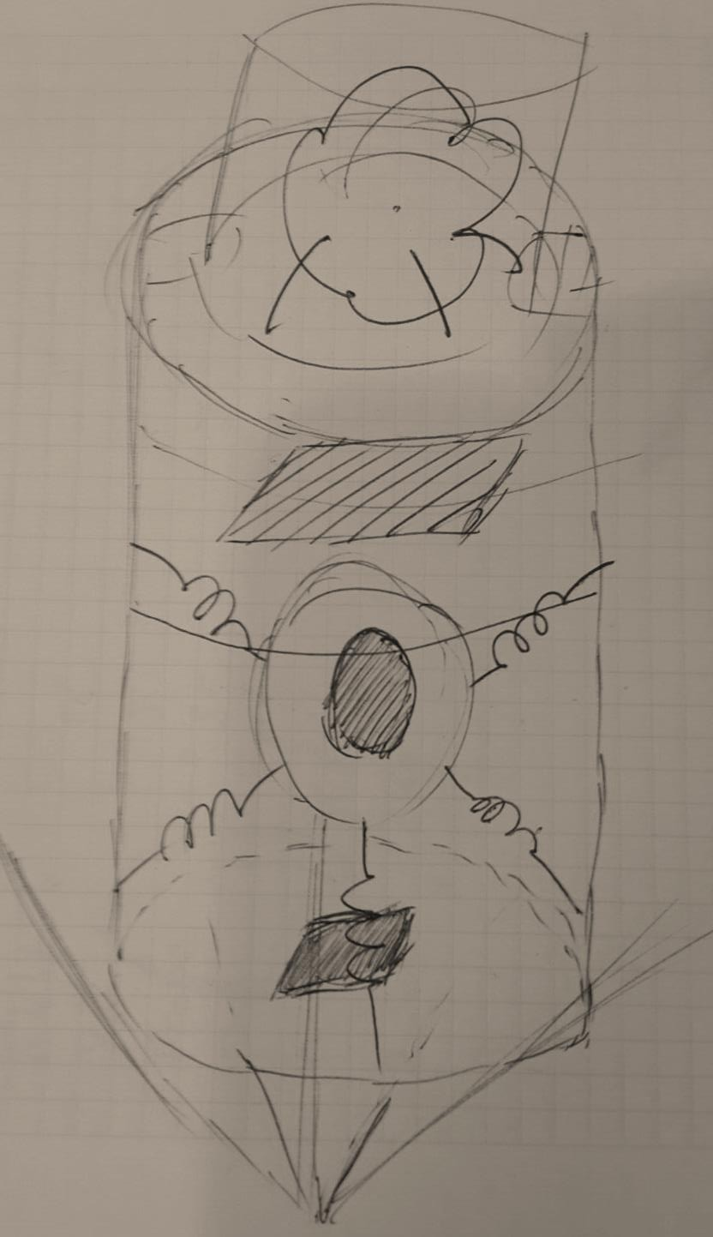
Team Logo
Here
(If You Want)
System Level CanSat Configuration
Trade & Selection
Pros
Pretty durable
Circular design suitable for rocket
Large interior space
Cons
High mass
Hard to produce
It is difficult to access the electronic part
Presenter: Miray Özbay
10

Slide 10
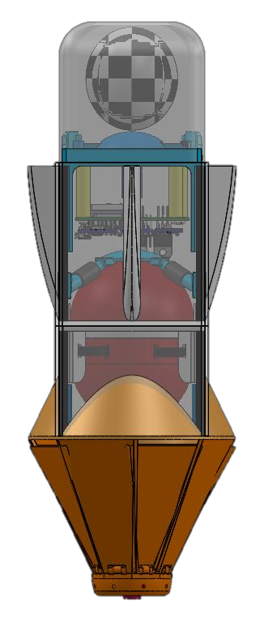
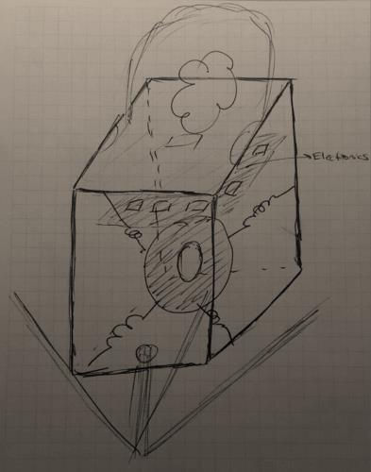
System Level CanSat Configuration
Trade & Selection(cont.)
Team Logo
Here
(If You Want)
Pros
Special protection part for electronic
part.
It is durable thanks to carbon rods.
Easy to acces electronic part.
Light weight
Cons
Thinner side faces.
There is more glue use.
SELECTED CONFIGURATION
More effective solution, robust frame. Easy to access all of the parts.
Presenter: Miray Özbay
10

Slide 11

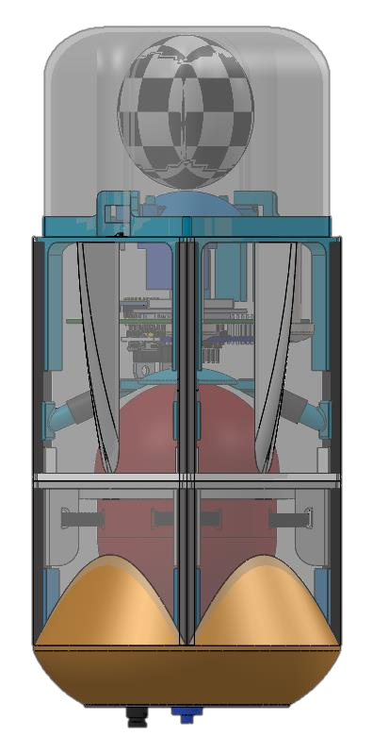


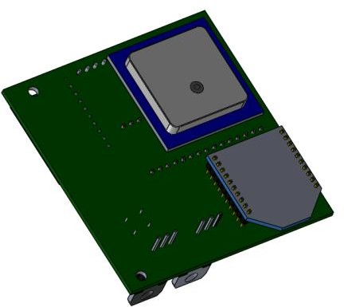
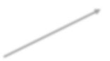



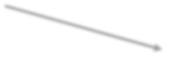



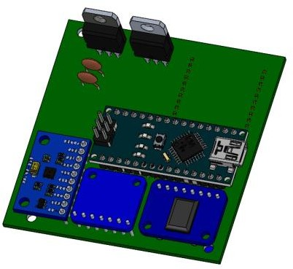




Physical Layout
Team Logo
Here
(If You Want)
Represents parachute
Parachute deployment mechanism
Heat sensor Battery
Electronics
Electronic protection surface
Parachute Case
GPS
Power switch
XBEE
Fin
Regulators
Arduino Nano
Screw mounting parts
Egg protection shell
Heat shield attachment part
MPU6050
Camera
RTC
Air pressure sensor
Presenter: Miray Özbay
10

Slide 12
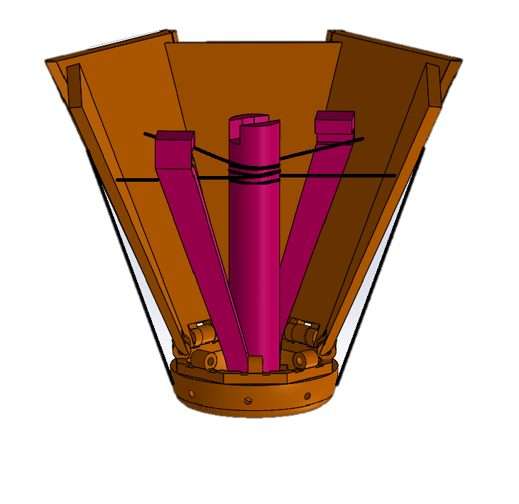
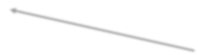







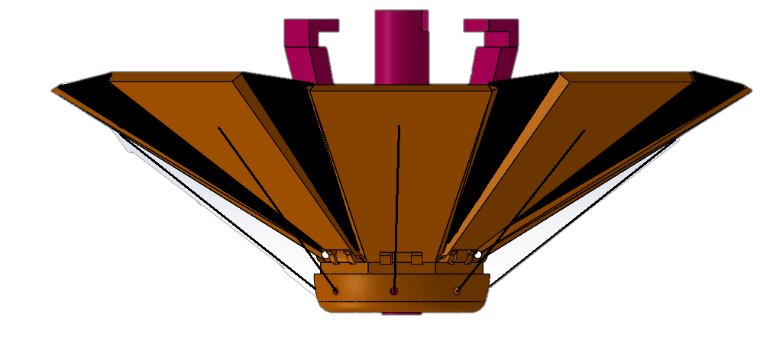

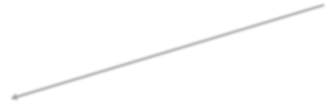
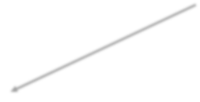


Physical Layout(cont.)
Team Logo
Here
(If You Want)
Probe Attachment Point
Launch Configuration
Servo Attachment Point
Nylon Threads
Support Bars
Pulley
Deployed Configuration
Hinges
Nose-Cone
Nylon Fabric
Flaps
Presenter: Miray Özbay
10

Slide 13
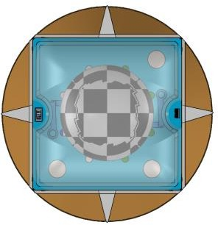
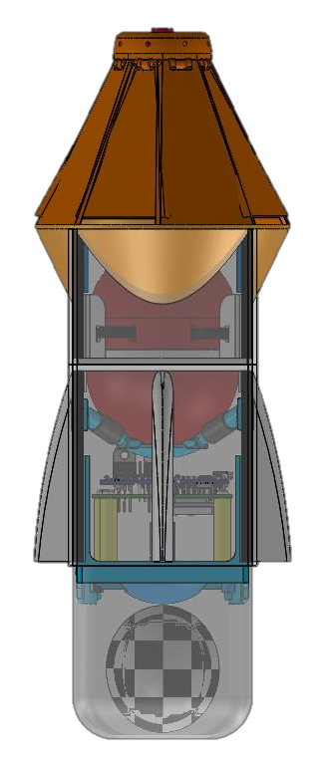
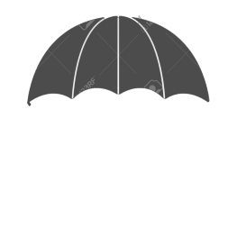
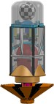
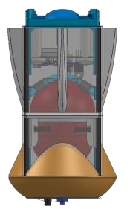
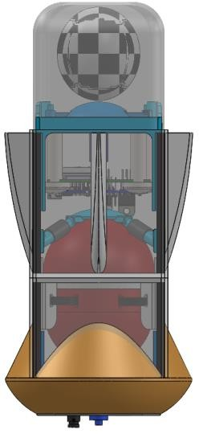
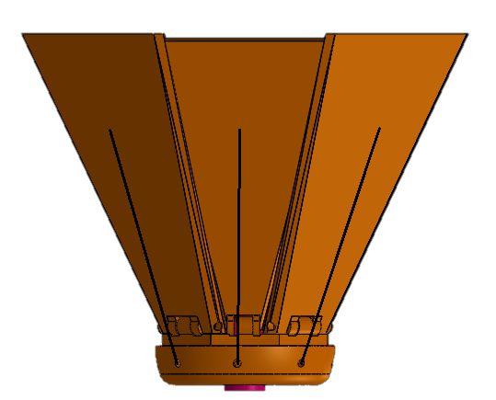
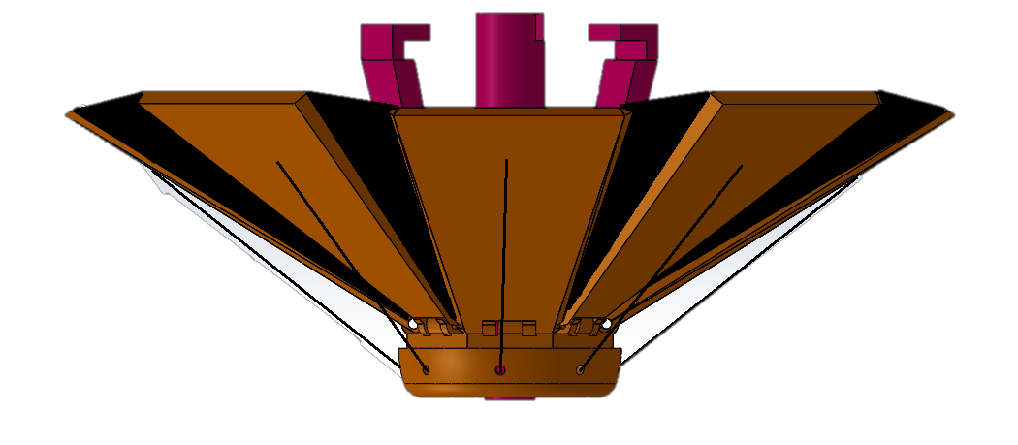

Physical Layout(cont.)
Team Logo
Here
(If You Want)
120mm
Launch
Deployed - 1
Deployed - 2
84mm
Top View
60mm
220mm
70mm
50mm
70mm
80mm
85mm
Side View
10mm
44mm
180mm
Presenter: Miray Özbay
10

Slide 14


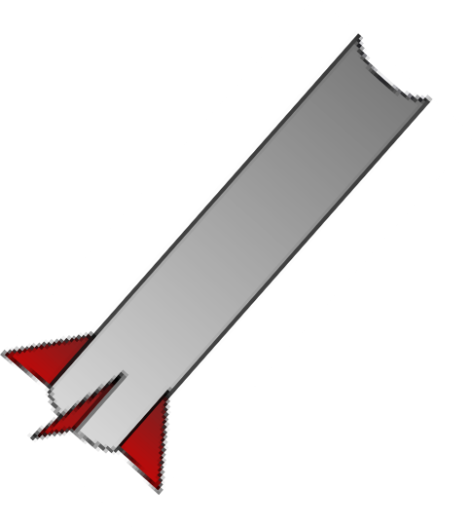








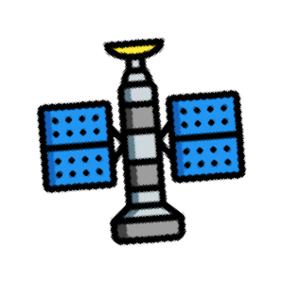



System Concept of Operations
Team Logo
Here
(If You Want)
Prelaunch to CanSat Seperation
5. CanSat descent
4. CanSat seperation
3. Launch
6. Descent with down position
1.Cansat preparation and power up prior to launch
2. Data link
verification on GCS
Presenter: Miray Özbay
10

Slide 15


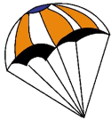
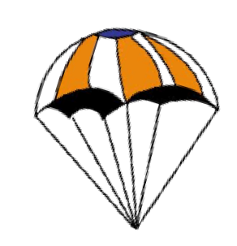

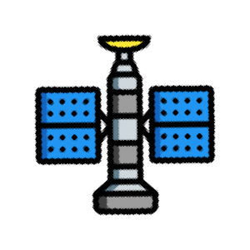

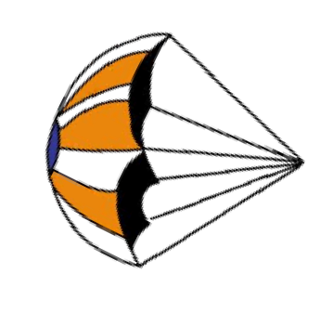


System Concept of Operations (cont.)
Team Logo
Here
(If You Want)
Heat Shield Release to Deployment with Parachute
Descent with down position
Heat Shield release from Probe at 300m
Probe parachute deployment and descent
10. Probe landing, telemetry disconnection, and activation of audio beacon
9. Probe software detection
final situation
Presenter: Miray Özbay
10

Slide 16
System Concept of Operations (cont.)
Team Logo
Here
(If You Want)
Recovery and Data Reduction
Recovery of probe with help of the observation in advance,
data from the GCS and audio beacon.
Recovery of heat shield; Landing zone will be determined by observing descent, by examining video that, probe records and, by last GPS location data.
Returning to launch site.
Acquiring saved flight data from probe.
Analyzing and filtering data if needed.
Presenter: Miray Özbay
10

Slide 17

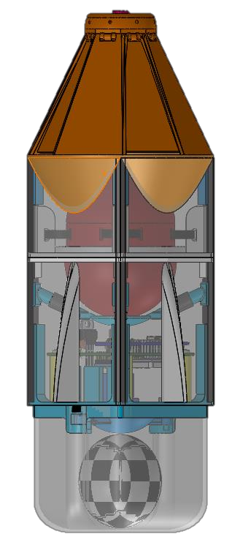






Launch Vehicle Compatibility
Team Logo
Here
(If You Want)
Fins have been added to ensure that the system does not tumble during descent.
305mm
310mm
There
are cause
no sharp it to get
edges to
stuck in the rocket.
120mm
Dimensions | Probe | Rocket | Margin
Diameter | 120 mm | 125 mm | 5 mm
Length | 305 mm | 310 mm | 5 mm
125mm
Presenter: Miray Özbay
10

Slide 18
Team Logo
Here
(If You Want)
Sensor Subsystem Design
Burhan Kaplan
CanSat 2018 PDR: #4128 Team CERVOS
18

Slide 19

Sensor Subsystem Overview
Team Logo
Here
(If You Want)
Airspeed Sensor | MPXV7002 Series | To Calculate Wind Speed | Probe
Real Time Clock | DS3231 | Check Real Time | Probe
Altitude, Pressure Sensor | BMP280 | Altitude & Air Pressure, | Probe
GPS | GY-NEO6MV2 | Check GPS Position | Probe
Tilt Sensor | MPU-6050 | Tilt about X,Y,Z | Probe
Camera | Y2000 | Video Recording | Probe
Voltage Sensor | Own Production | Check Instantaneous Voltage | Probe
Temperature Sensor | LM35 | External Temperature | Probe
Presenter: Burhan Kaplan

Slide 20
Sensor Subsystem Requirements
Team Logo
Here
(If You Want)
ID | REQUIREMENT | RATIONALE | PARENT | VM
 |  |  |  | A | D | I | T
SS-1 | Cost of the CanSat shall be under $1000. Ground support and analysis tools are not included in the cost. | Protect cost efficiency | - | X
SS-2 | A tilt sensor shall be used to verify the stability of the probe during descent with the heat shield deployed and be part of the telemetry. | Stability of probe | - | X |  |  | X
SS-3 | All electronic components shall be enclosed and shielded from the environment with the exception of sensors. | Electronic system protection | - |  |  | X
SS-4 | All electronics shall be hard mounted using proper mounts such as standoffs, screws, or high performance adhesives. | Electronic system protection | - |  | X | X
Presenter: Burhan Kaplan

Slide 21
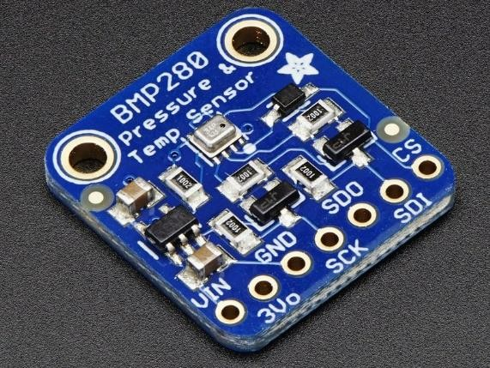
Probe Air Pressure Sensor
Trade & Selection
Team Logo
Here
(If You Want)
Manufacturer | Model | Dimensions / Weight | Interfacing | Power Consumption | Specifications | Cost
Adafruit | BMP280 | 3.6 x 3.8 mm | I2C, SPI | 2.7 µA | Temperature measurement included Pressure range: 300 - 1100hPa 0.016hPa Resolution -40 to +85°C operational range | $9.95
Adafruit | BMP085 | 5.0 x 5.0 mm | I2C | 5 µA | Pressure range: 300 - 1100hPa 1hPa Resolution -40 to +85°C operational range | $19.95
SparkFun | MPL115A1 | 5.0 x 3.0 mm | SPI | 5 µA | Pressure range: 500 -1150hPa 1.5hPa Resolution -40 to +105°C operational range | $12.95
Probe Air Pressure Sensor Chosen : Adafruit BMP280
Simple interface
Compact size
Large pressure range
Cheaper than rivals
5V and 3.3V operation
Presenter: Burhan Kaplan

Slide 22
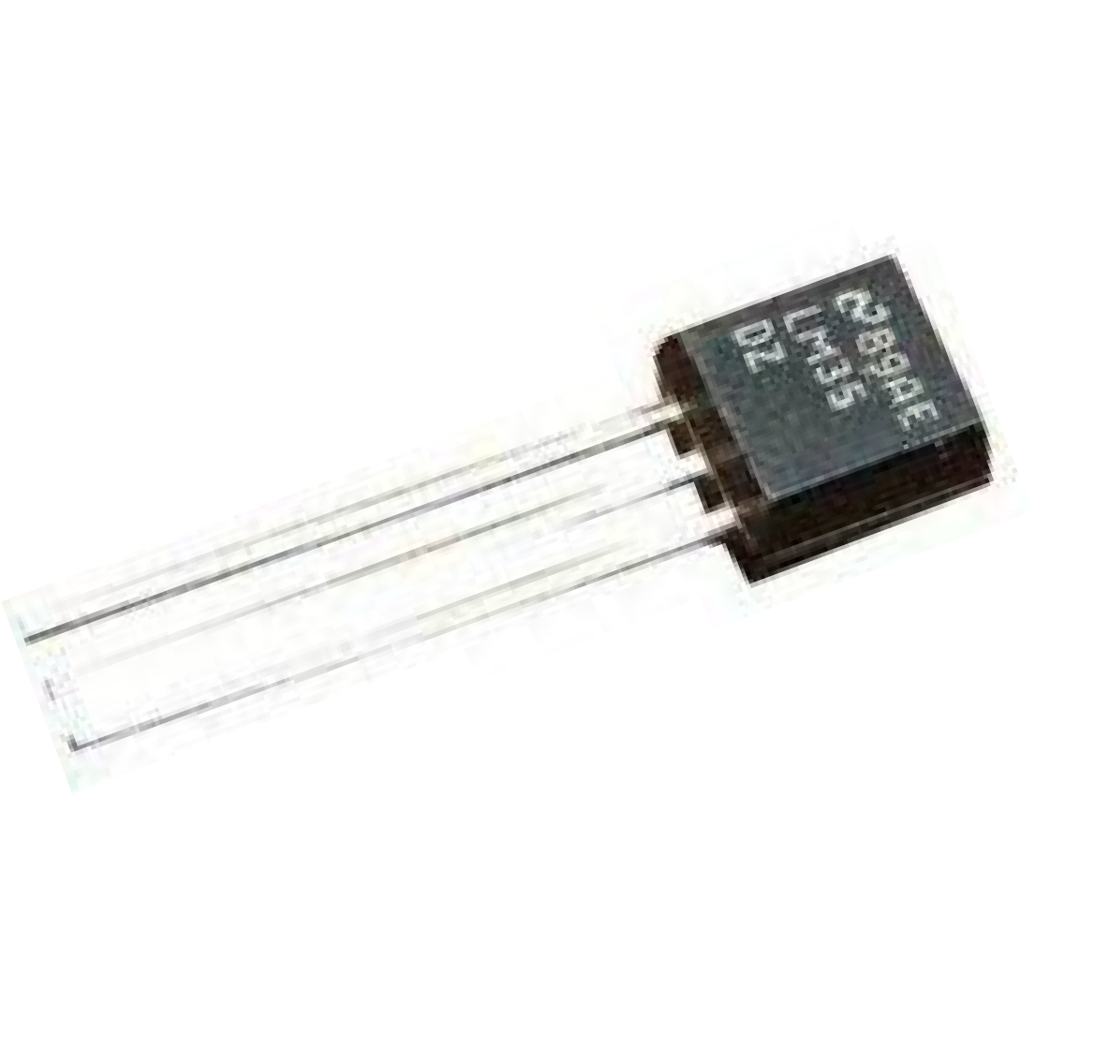
Probe Air Temperature Sensor
Trade & Selection
Team Logo
Here
(If You Want)
Manufacturer | Model | Dimensions / Weight | Interfacing | Power Consumption | Specifications | Cost
Texas Instrument | LM35 | 4.3 x 4.3 mm /1g | Analog | 60 μA | Temperature Range: −55°C to 150°C Accuracy: ±0.25°C | $1
Sensirion | SHT31 | 2.6 x 2.6mm /1g | I2C | 800 μA | Temperature Range : −40°C to 125°C Accuracy: ±0.30°C | $8.5
Adafruit | MCP9808 | 21 x 13 mm | I2C | 200 μA | Temperature Range : −40°C to 125°C Accuracy: ±0.25°C | $13.95
Probe Air Temperature Sensor Chosen : LM35
Suitable for Remote Applications
Very low self-heating of less than 0.1°C in still air.
High cost efficiency
Proper size to integrate
Presenter: Burhan Kaplan

Slide 23
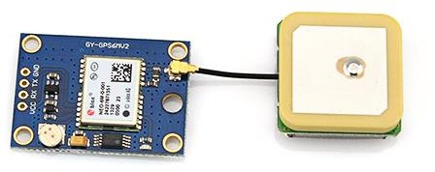
GPS Sensor
Trade & Selection
Team Logo
Here
(If You Want)
Manufacturer | Model | Dimensions/ Weight | Interfacing | Specifications | Cost
U-blox | GY-NEO6MV2 GPS Module | 25x35mm/ 16g | UART, USB, and DDC | 50 Channels Supply Voltage:2.7 – 3.6 V Position Accuracy: < 3 meters Max. supply current : 67mA Velocity accuracy : 0.1 m/s Sensitivity: -160 dBm | $11.90
Adafruit | Ultimate GPS Breakout | 25x35mm/ 8.5g | UART | 60 Channels Supply Voltage: 3.0-5.5 V Position Accuracy: < 3 meters Velocity Accuracy: 0.1 meters/s Max. supply current: 45mA Velocity accuracy : 0.1m/s Sensitivity: -165 dBm | $39.95
Probe Gps Sensor Chosen : GY-NEO6MV2 GPS module
Cheaper than rivals
Low Power consumption (Has Eco mode)
Good resolution
Higher accuracy
Presenter: Burhan Kaplan

Slide 24
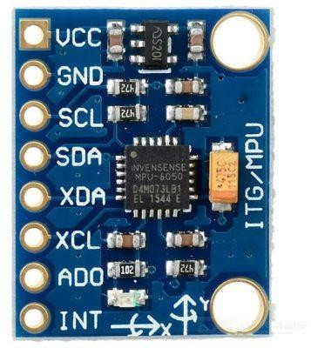
Tilt Sensor Sensor
Trade & Selection
Team Logo
Here
(If You Want)
Manufacturer | Model | Dimensions/ Weight | Interfacing | Specifications | Cost
InvenSense | GY-521 MPU6050 | 30 x 20 mm /18g | I2C | 9-Axis MotionFusion Operating current: 3.9mA Gyro Range: ± 250 500 1000 2000 ° / s Acceleration range: ± 2 ± 4 ± 8 ± 16g | $4.52
Adafruit | MMA8451 | 14.5 x 20.5 | I2C | 3-Axis accelerometer Acceleration range: ± 2 ± 4 ± 8 ± 16g | $7.95
Probe Tilt Sensor Chosen : GY-521 MPU6050
3-axis gyroscope and a 3-axis accelerometer on the same with an onboard Digital Motion Processor.
Out of rotation values (in angles) using an MPU-6050 gyro and accelerometer sensor.
Cost efficiency
Good resolution for tilt
Presenter: Burhan Kaplan

Slide 25
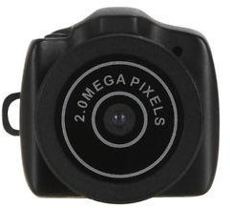
Bonus Camera Trade & Selection
Team Logo
Here
(If You Want)
Manufacturer | Model | Dimensions/ Weight | Interfacing | Specifications | Cost
CADeN | Y2000 | 35 x 30 x 30 mm/ 9g | USB 2.0 | Video Resolution :640 x 480 Frame rate :30fps Video format: AVI 2.0 Mega pixel video recording | $6.99
OCDAY | Mini Camera X6 | 45x 29 x 15 mm / 50g | USB 2.0 | Video Resolution :1280 x 960 Frame rate :30fps Video format: AVI | $12.50
Bonus Camera Chosen :Y2000
Has internal micro SD card reader
Has internal processor
Higher cost efficiency
Lightweight
Presenter: Burhan Kaplan

Slide 26
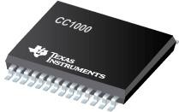
Bonus Wind Sensor
Team Logo
Here
(If You Want)
Manufacturer | Model | Interfacing | Specifications | Cost
Texas Instruments | CC1000PW | SPI,UART | RF Transceiver IC 315MHz, 433MHz, 868MHz, 915MHz; Power Out 10dBm (Max); sensitivity -110dBm Operating voltage : 3.3V | $11.15
IC Chip Chosen :CC1000PW
Radio design
have made by transceiver IC and external
components, capacitors and inductors choosed for antenna matching, Crystal oscillator choosed for 433 MHz ISM band, SPI interfacing and Arduino nano choosed for programming IC.
Receiver design is same as trasnmitter design except registers of IC have different configurations.
Frequency of signal will change by changing frequency deviation by programming registers in IC.
Originally transciever IC has 2 channels with different specifications(Power out, Frequency deviation, etc.) by programmed arduino nano and with help of button, every channel in 433MHz ISM band can be implemented in IC.
Presenter: Burhan Kaplan
27

Slide 27
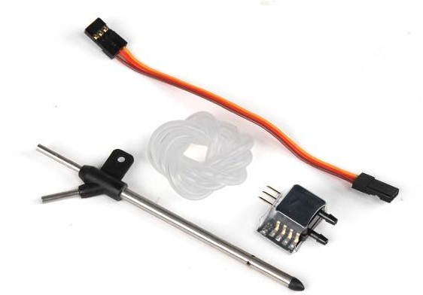
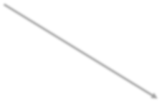
Bonus Wind Sensor(conts.)
Team Logo
Here
(If You Want)
Manufacturer | Model | Dimensions / Weight | Interfacing | Specifications | Cost
NXP Semiconductors | MPXV7002DP | Sensor 11 x 17 mm Tube 80 mm 4 g | ADC | Operating Temperature :0 to +85 °C Supply Voltage: 3.3V Resolution: 1kPa | $26.03
Air Speed Sensor Chosen : MPXV7002DP
We will use air speed sensor and gps data to measure the wind speed at Z axis.
We will use only gps data to measure wind speed on x-y plane. Because we need only velocity vector of probe to find the wind speed which acts on probe on x-y plane
X-Y Plane Wind Speed Vector.
Total Air Speed Vector
Z - Axis Wind Speed Vector
Presenter: Burhan Kaplan
27

Slide 28
Team Logo
Here
(If You Want)
Descent Control Design
Mustafa Eryılmaz
CanSat 2018 PDR: #4128 Team CERVOS
28

Slide 29



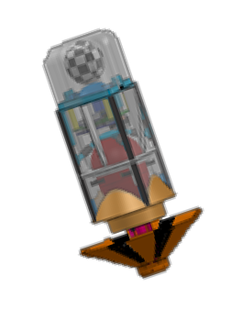



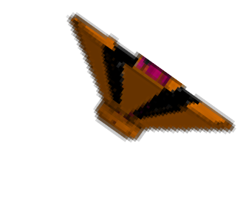
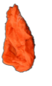

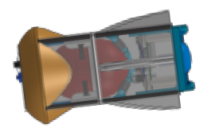
Descent Control Overview
Team Logo
Here
(If You Want)
Heat Shield Descent Control System
Heat shield consists 8 active surfaces.
720m
In the rocket, heat shield will stay in stowed configuration.
After deployed from rocket, heat shield will open and it will reduce the speed of the probe to 10-30m/s until 300 meters.
Probe will release the heat shield at 300 meters.
Probe Descent Control System
Probe has a octagonal parachute with a diameter of 80 cm and a spill hole for prevent drifting .
300m
At first, the parachute is in stowed
configuration. At 300 meters, probe will deploy parachute and descent speed will be reduced to 5m/s.
Ground
Presenter: Mustafa Eryılmaz

Slide 30
Descent Control Requirements
Team Logo
Here
(If You Want)
ID | Requirement | Rationale | Parent | VM
 |  |  |  | A | D | I | T
DC-1 | The aero-braking heat shield shall be used to protect the probe while in the rocket only and when deployed from the rocket. It shall envelope/shield the whole sides of the probe when in the stowed configuration in the rocket. The rear end of the probe can be open. | Ensuring that all systems are not damaged and, ensuring proper landing | SR-2 |  | X
DC-2 | The probe must maintain its heat shield orientation in the direction of descent. | Heat shield protect the probe from heat | - |  | X
DC-3 | The probe shall not tumble during any portion of descent. Tumbling is rotating end-over-end. | To protect the probe and its interior | - | X |  |  | X
DC-4 | The CanSat, probe with heat shield attached shall deploy from the rocket payload section. | Competition Requirement | SR-4
DC-5 | The aero-braking heat shield shall be released from the probe at 300 meters. | Competition Requirement | SR-5 |  | X |  | X
DC-6 | The probe shall deploy a parachute at 300 meters. | Competition Requirement | SR-6 |  | X |  | X
DC-7 | The descent rate of the probe with the heat shield deployed shall be between 10 and 30 meters/second. | Competition Requirement | - | X |  |  | X
DC-8 | The descent rate of the probe with the heat shield released and parachute deployed shall be 5 meters/second. | Competition Requirement | - | X |  |  | X
Presenter: Mustafa Eryılmaz

Slide 31
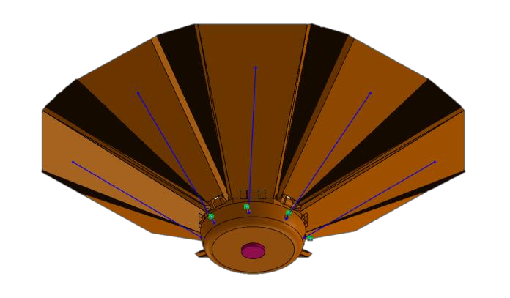
Payload Descent Control Strategy
Selection and Trade
Team Logo
Here
(If You Want)
Probe with heat shield;
Drag Coefficent Trade | Mass(g) | Shape | Pros | Cons
Lower Drag | 90 | Hexagonal | Easy to operate More surface area Reduced drag | Hard to produce Hard to design
Higher Drag | 80 | Square | Low mass Easy to produce | Not very effective
Selection : Hexagonal Shape Heat Shield
More reliable working princible.
Lower drag which makes easy to control position of probe.
Higher probabilty of maintain desired direction while descent.
Presenter: Mustafa Eryılmaz

Slide 32
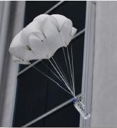
Payload Descent Control Strategy
Selection and Trade(cont.)
Team Logo
Here
(If You Want)
Probe with parachute;
Manufacturer | Diameter(cm) | Mass(g) | Shape | Spill Hole | Tests
Hand-Made | 80 | 40 | Circular | No | Drifts too much Durable string connections Hard to have perfect shape
Hand-Made | 80 | 36 | Hexagonal | Yes | Drifts less Durable string connections Perfect production
Selection : Hand-made Hexagonal
Commercial parachutes are hard to find in our country.
Hexagonal structure is easy to construction.
Previous experience.
Easy to adjust.
Presenter: Mustafa Eryılmaz

Slide 33
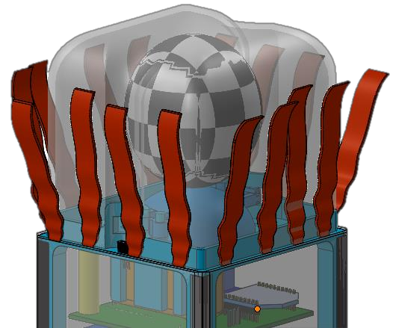
Team Logo
Here
(If You Want)
Descent Stability Control Strategy
Selection and Trade
Configuration 1 : Ribbon
Ribbons are
used for passive
stability control.
Inspired by kite tail.
Drag force is increased at the top of the probe, so during descent nadir direction will be maintained.
No mechanism.
Pros | Cons
Very easy solution | May not enough for kept nadir direciton
No mechanism needed | May cause stucking problems during seperation
Low weight
Presenter: Mustafa Eryılmaz

Slide 34
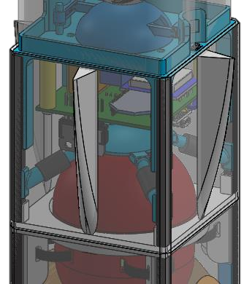
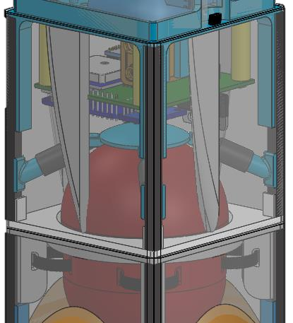
Descent Stability Control Strategy
Selection and Trade (cont.)
Team Logo
Here
(If You Want)
Configuration 2 : Fins
Fins used for passive stability control.
Inspired by rocket and bomb systems.
Drag force is increased at the top of the probe, so during descent nadir direction will be maintained.
Parachute deploy mechanism will be used to move fins.
Pros | Cons
Easy to implement | Direct contact with the air required (heat shield may couse problems)
Basic structure | Need of mechanism for stowed to deployment configuration
Low weight
CHOSEN CONFIGURATION
More effective solution, more reliable and easy to modify the shape.
Presenter: Mustafa Eryılmaz

Slide 35
Descent Rate Estimates
Team Logo
Here
(If You Want)
Used formulas;
𝑣: 𝑣𝑒𝑙𝑜𝑐𝑖𝑡𝑦
𝑚_{Τ𝑠}
(1) 𝑣 =
2∗𝑚∗𝑔
𝐹_{𝑑𝑟𝑎𝑔}: 𝑑𝑟𝑎𝑔 𝑓𝑜𝑟𝑐𝑒 𝑁
𝐴: 𝑎𝑟𝑒𝑎 𝑚²
𝐴∗𝜌∗𝐶_{𝑑}
𝜌: 𝑎𝑖𝑟 𝑑𝑒𝑛𝑠𝑖𝑡𝑦
𝑘𝑔ൗ
𝑚
3
𝐶_{𝑑}: 𝑑𝑟𝑎𝑔 𝑐𝑜𝑒𝑓𝑓𝑖𝑐𝑖𝑒𝑛𝑡
𝑚: 𝑚𝑎𝑠𝑠 𝑘𝑔
𝑔: 𝑔𝑟𝑎𝑣𝑖𝑡𝑎𝑡𝑖𝑜𝑛𝑎𝑙 𝑎𝑐𝑐. (^{𝑚}Τ_{𝑠}2)
𝑥: 𝑑𝑖𝑠𝑡𝑎𝑛𝑐𝑒 𝑚
𝑡: 𝑡𝑖𝑚𝑒 𝑠
(2) x = ¹ ∗ 𝑎 ∗ 𝑡²
2
(3) x = 𝑣 ∗ 𝑡
Presenter: Mustafa Eryılmaz

Slide 36
Descent Rate Estimates(cont.)
Team Logo
Here
(If You Want)
Heat shield + Probe post rocket-separation;
CAD estimations are used to find 𝐶_{𝑑} . Formulas (2) and (3) are used to find approximate descent velocities for CAD simulations. Air density assumption was made for Stephenville in June.
𝜌: 1.175 ^{𝑘𝑔}ൗ
3 , 𝐶_{𝑑} : 0.5, m:498gr, 𝑔 ∶ 9.81 ^{𝑚}Τ 2 ,
𝑅: 12𝑐𝑚
𝑚
𝑠
Estimated Descent Rate
38.3 ^{𝑚}Τ_{𝑠}
Presenter: Mustafa Eryılmaz

Slide 37
3 , 𝐶_{𝑑} : 0.6, m:498gr,
Team Logo
Here
(If You Want)
Descent Rate Estimates(cont.)
Probe after heat shield deployed;
𝜌: 1.175 ^{𝑘𝑔}ൗ
𝑔 ∶ 9.81 ^{𝑚}Τ 2 ,
𝑅: 18𝑐𝑚
𝑚
𝑠
Estimated Descent Rate
23.3 ^{𝑚}Τ_{𝑠}
Heat shield after being released;
𝜌: 1.175 ^{𝑘𝑔}ൗ
3 , 𝐶_{𝑑} : 0.6, m:85gr,
𝑔 ∶ 9.81 ^{𝑚}Τ 2 ,
𝑅: 18𝑐𝑚
𝑚
𝑠
Estimated Descent Rate
10.6 ^{𝑚}Τ_{𝑠}
Presenter: Mustafa Eryılmaz

Slide 38
Descent Rate Estimates(cont.)
Team Logo
Here
(If You Want)
Probe following separation from the Heat shield;
By using formula (1), we can easily calculate descent rate of probe with parachute. %4 swaying hole for parachute included.
𝜌: 1.175 ^{𝑘𝑔}ൗ
3 , 𝐶_{𝑑} : 0.75, m:413gr, 𝑔 ∶ 9.81 ^{𝑚}Τ 2 ,
𝑅: 18𝑐𝑚
𝑚
𝑠
Diameter(corner to corner) (cm) | Descent Rate (m/s)
60 | 6.66
80 | 4.99
100 | 4.00
Presenter: Mustafa Eryılmaz

Slide 39
Descent Rate Estimates(cont.)
Team Logo
Here
(If You Want)
Diameter(corner to corner) (cm) | Descent Rate (m/s)
Heat shield + Probe post rocket-separation | 38.3
Probe after heat shield deployed | 23.3
Heat shield after being released | 10.6
Probe following separation from the Heat shield | 4.99
We can clearly see that, heat shield deployment causes slow down on probe speed. After releasing heat shield and deployment of parachute, descent rate reduces to 5m/s.
Presenter: Mustafa Eryılmaz

Slide 40
Team Logo
Here
(If You Want)
Mechanical Subsystem Design
Ahmet Vehbi Genç
CanSat 2018 PDR: #4128 Team CERVOS
40

Slide 41
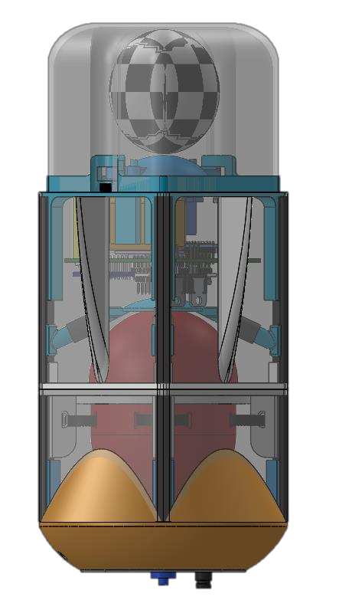
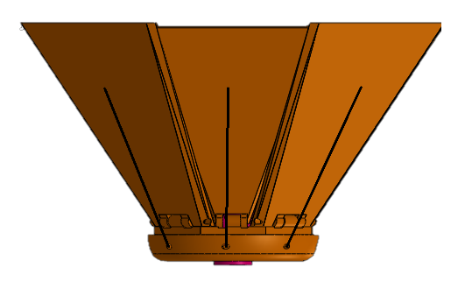
Mechanical Subsystem Overview
Team Logo
Here
(If You Want)
Probe Frame
Includes PLA components, carbon fiber rods, plastic coatings. This configuration makes the probe lightweight and durable.
Parachute System
Includes parachute, parachute cover, servo, servo cover, and deployment system.
Electronics
Electronics will be mounted using stand-off.
Battery will secured using velcro and double sided band. Electronics are protecting by electronic protection surface.
Egg Protection System
Includes egg shells, sponges, dampers and clamps.
Heat Shield System
Includes 8 opening flaps, opening and releasing servo mechanism.Orange colored PLA is used. Nylon strings are part of mechanism. Nylon fabric is used to ensure not any openings.
Presenter: Ahmet Vehbi Genç

Slide 42
Mechanical Sub-System
Requirements
Team Logo
Here
(If You Want)
ID | Requirement | Rationale | Parent | VM
 |  |  |  | A | D | I | T
MS-1 | Total mass of the CanSat (probe) shall be 500 grams +/- 10 grams | Limits mass budget | SR-1 |  |  | X
MS-2 | The aero-braking heat shield shall be used to protect the probe while in the rocket only and when deployed from the rocket. It shall envelope/shield the whole sides of the probe when in the stowed configuration in the rocket. The rear end of the probe can be open. | To protect the probe while in the rocket. | SR-2 |  | X | X
MS-3 | The heat shield must not have any openings | Competition requirement | - |  | X
MS-4 | The probe with the aero-braking heat shield shall fit in a cylindrical envelope of 125 mm diameter x 310 mm length. Tolerances are to be included to facilitate container deployment from the rocket fairing. | Compatibility with rocket | - |  |  | X
MS-5 | The probe shall hold a large hen's egg and protect it from damage from launch until landing. | Competition requirement | - |  | X
MS-6 | The probe shall accommodate a large hen’s egg with a mass ranging from 54 grams to 68 grams and a diameter of up to 50mm and length up to 70mm. | Competition requirement | - |  |  | X
MS-7 | The aero-braking heat shield shall not have any sharp edges to cause it to get stuck in the rocket payload section which is made of cardboard. | Prevention from getting stuck in the rocket | - |  | X
Presenter: Ahmet Vehbi Genç

Slide 43
Mechanical Sub-System
Requirements(cont.)
Team Logo
Here
(If You Want)
ID | Requirement | Rationale | Parent | VM
 |  |  |  | A | D | I | T
MS-8 | The aero-braking heat shield shall be a florescent color; pink or orange. | Ease of retrieval after landing | SR-3 |  |  | X
MS-9 | The rocket airframe shall not be used to restrain any deployable parts of the CanSat. | Compatibility with rocket | - |  | X
MS-10 | The rocket airframe shall not be used as part of the CanSat operations. | Competition requirement | - |  | X
MS-11 | The CanSat, probe with heat shield attached shall deploy from the rocket payload section. | Competition requirement | SR-4 |  | X
MS-12 | All descent control device attachment components (aero- braking heat shield and parachute) shall survive 30 Gs of shock. | Damage prevention | - | X |  |  | X
MS-13 | All descent control devices (aero-braking heat shield and parachute) shall survive 30 Gs of shock. | Damage prevention | - | X |  |  | X
MS-14 | All electronic components shall be enclosed and shielded from the environment with the exception of sensors. | Safe of all electronics | - |  |  |  | X
MS-15 | All structures shall be built to survive 15 Gs of launch acceleration. | Damage prevention | - | X |  |  | X
MS-16 | All structures shall be built to survive 30 Gs of shock. | Damage prevention | - | X |  |  | X
Presenter: Ahmet Vehbi Genç

Slide 44
Mechanical Sub-System
Requirements (cont.)
Team Logo
Here
(If You Want)
ID | Requirement | Rationale | Parent | VM
 |  |  |  | A | D | I | T
MS-17 | All electronics shall be hard mounted using proper mounts such as standoffs, screws, or high performance adhesives | Safe of all electronics | - | X |  |  | X
MS-18 | All mechanisms shall be capable of maintaining their configuration or states under all forces. | Damage prevention | - | X |  |  | X
MS-19 | Mechanisms shall not use pyrotechnics or chemicals | Competition requirement | -
MS-20 | Mechanisms that use heat (e.g., nichrome wire) shall not be exposed to the outside environment to reduce potential risk of setting vegetation on fire. | Safety | - |  |  | X
MS-21 | Both the heat shield and probe shall be labeled with team contact information including email address. | CanSat loss prevention | - |  |  | X
MS-22 | No lasers allowed. | Competition requirement | -
MS-23 | The probe must include an easily accessible power switch. | Safety | SR-13 |  | X | X
MS-24 | The probe must include a power indicator such as an LED or sound generating device. | To be informed about power without opening probe or using software | - |  | X | X
MS-25 | An audio beacon is required for the probe. It may be powered after landing or operate continuously. | To find probe easily after landing | - |  | X | X
MS-26 | An easily accessible battery compartment must be included allowing batteries to be installed or removed in less than a minute and not require a total disassembly of the CanSat. | To replace battery quickly at the competition field | SR-14 |  | X |  | X
Presenter: Ahmet Vehbi Genç

Slide 45
Probe Mechanical Layout of
Components Trade & Selection
Team Logo
Here
(If You Want)
Component | Issues | Material | Chosen | Rationale
Probe Shells | It must be resistant to the impacts received. The mass limit should not be exceeded. It should not be flexible to prevent the load in the probe from moving. It should survive 30Gs shock. | PLA, Composite, Balsa, plactic coat, carbon fiber rod | PLA, plasic coat, carbon fiber rod | Low mass Easy and detailed production Thanks to the 3D printer, you can test more.
Parachute Release System | It must be able to withstand the applied acceleration of 30Gs during the drop, and the parachute release mechanism must be able to operate during acceleration of 30Gs. The mass must be low. | Balsa, PLA, Aluminum | PLA | Easy and detailed production Low mass Thanks to the 3D printer, you can test more.
Parachute Springs | It must be strong enough to launch the parachute box during the acceleration of 30Gs applied during the fall. | Steel alloy, Nickel alloy, Plastic | Plastic | Easy to find Low cost The contact surface is wider
Parachute | It should keep the cabin speed at 5 m / s during descent. | Special fabric, standart fabric, nylon | Special fabric | Durable and tear- free. Low mass
Presenter: Ahmet Vehbi Genç

Slide 46
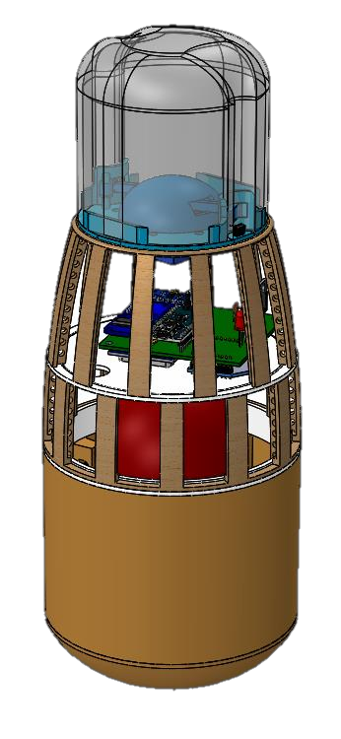
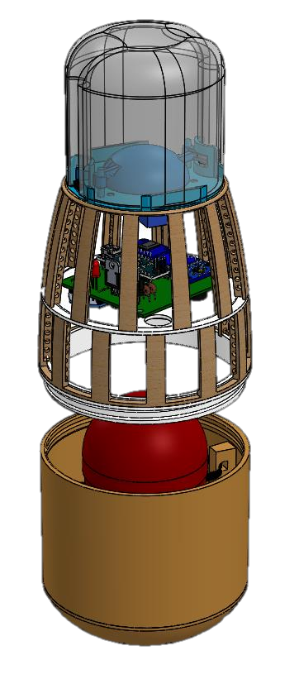


















Probe Mechanical Layout of
Components Trade & Selection(cont.)
Team Logo
Here
(If You Want)
Mechanical Design 1 | Description | Pros | Cons
Circular Rotary Design | Probe consists of 2 main cylindrical parts. The first part has an electronic part and a parachute deployment system. Electronic part is glued to the probe. Diameter of the first part approaches the parachute mechanism, it shrinks to reduce the mass. The second part contains heat shield deployment system and an egg protection shell. The egg protection shell is attached to the container with clamps. The two parts are connected to each other by screw mounting. | Pretty durable Circular design suitable for rocket Large interior space | High mass Hard to produce It is difficult to access the electronic part
Parachute deployment mechanisim
Parachute deployment servo
Heat sensor
On-off switch
Electronics
Lenght : 210mm
Balsa wood stick
Screw mount mechanisim
Clamp
Egg protection
3D Printed PLA
Camera
Heat shield release servo
Heat shield attachment points
Diameter : 120mm
Presenter: Ahmet Vehbi Genç

Slide 47






















Probe Mechanical Layout of
Components Trade & Selection(cont.)
Team Logo
Here
(If You Want)
Mechanical Design 2 | Description | Pros | Cons
Square Rotary Design | The system consists of 2 main square prism parts. The first part is equipped with electronics and parachute deployment mechanism. The electronic part is screwed into top of the probe. There is a protective surface between the electronic part and the egg protection shell. The second part is equipped with egg protection shell and heat shield release mechanism. The egg protection shell is attached to the carbon rods with clamps. | Special protection part for electronic part It is durable thanks to carbon rods. Easy to acces electronic part. By getting rid of the unused areas, it is gained from the mass | Thinner side faces There is more glue use
Parachute deployment mechanisim
Parachute
Parachute deployment servo
Electronics
Camera
Fin
218mm
Plastic coating
Heat sensor
Egg protection
On-off switch
Heat shield attechment points
Protective Surface
CHOSEN CONFIGURATION
Low mass, easy to build, easy to acces parts, basic structure
Clamp
Carbon rods
Heat shield release servo
120mm
Presenter: Ahmet Vehbi Genç
47

Slide 48

















Payload Pre Deployment
Configuration Trade & Selection
Team Logo
Here
(If You Want)
Represents parachute
Represents nylon threads
Probe’s
top component
This is how we kept payload parachute and heat shield in stowed configuration.
Presenter: Ahmet Vehbi Genç

Slide 49
Heat Shield Deployment
Configuration Trade & Selection
Team Logo
Here
(If You Want)
Issues |  | Solutions
The aero-braking heat shield shall be used to protect the probe while in the rocket only and when deployed from the rocket. |  | Heat shield will protect to probe when the deployed configuration, like an umbrella.
The heat shield must not have any openings. |  | We stretched nylon fabric material between the flaps.
Mechanical Layouts | Description |  | Pros | Cons
Thrust System | There are four flaps inner side of heat shield and there are connected to rotating system which is middle of the heat shield. When the rotating system rotate 90 degrees, inner four flaps push the other flaps. |  | -Less complex structure -Thick flaps and nose- cone -More durable | -High-weight -Less stable -Short flaps -Not open enough
Traction System | All flaps connected to pulley system from inside and outside with nylon thread. When the pulley system rotate, outside connection will pull all flaps and inside connection will balance the flaps |  | -Can be opened more -More stable -Low-weight -Long flaps | -More complex structure -Small nose-cone -Hard to assemble -Harder to manufacture -Thin flaps and nose- cone
Presenter: Ahmet Vehbi Genç

Slide 50





















Heat Shield Deployment
Configuration Trade & Selection(cont.)
Team Logo
Here
(If You Want)
Mechanical Design 1 | Description | Pros | Cons
Arms Connected Heat Shield | We have four arms and there are attach the inner flaps. When the rotating system rotate by servo motor, arms will push the inner flaps then inner flaps will enter between outer flaps and heat shield will be in deployment position. | -More durable structure(Flaps,Nose- Cone,Hinges) | -Cannot be opened enough -Arms are not durable
ATTACHMENT POINTS
OUTER FLAPS
NOSE-CONE
HINGES
INNER FLAPS
ROTATING SYSTEM
ARMS
Presenter: Ahmet Vehbi Genç

Slide 51



























Heat Shield Deployment
Configuration Trade & Selection(cont.)
Team Logo
Here
(If You Want)
Mechanical Design 2 | Description | Pros | Cons
String Connected Heat Shield | In this system, inner and outer face of all flaps attach to pulley system with nylon threads. When the pulley system rotate by the servo motor all flaps will pull outward by nylon threads which are attached to outer faces. When the heat shield is in deployment position the nylon threads which are attached to inner faces will keep flaps stable. | -More stable -Useful for mission -Can be open enough | -More complex -More detailed -Not easy production
ATTACHMENT POINTS
NYLON THREADS
FLAPS
NYLON FABRICS
RELEASE MECHANISM
CHOSEN CONFIGURATION
More stable, useful and durable.
Can be opened as desire.
NOSE-CONE
PULLEY SYSTEM
Presenter: Ahmet Vehbi Genç

Slide 52
Heat shield Mechanical Layout of
Components Trade & Selection
Team Logo
Here
(If You Want)
Component | Issues | Material | Chosen | Rationale
Flaps | Should be light and thin and besides must be durable and smooth | PLA, Aluminum, Plywood | PLA | -Low-weight and thin -Easy and detailed production -Thanks to the 3D printer, we can test more.
Nose-Cone | Should be light and thin and besides must be durable and smooth | PLA ABS | PLA | -Low-weight and thin -Easy and detailed production -Thanks to the 3D printer, we can test more.
Gap Between Two Flaps | Should be elastic, light and foldable | Nylon Fabric Cloth | Nylon Fabric | -Easy production -Occupies low volume -Easy to shape
Deployment System | -The hinges and pulley system should not break. -The connecting material we use must be durable | -PLA -ABS -Nylon Thread -Rope | -PLA -Nylon Thread | -Low-weight and thin -Easy and detailed production -Durable and elastic
Release System | The supports used for the release mechanism must have smooth edge | PLA,ABS Plywood Plastic | PLA | -Easy and detailed production -Thanks to the 3D printer, we can test more.
Presenter: Ahmet Vehbi Genç

Slide 53













Heat shield Release Mechanism
Team Logo
Here
(If You Want)
DEPLOYED POSITION
SUPPORT BARS
DISC
After the heat shield deployment, disk will be
PULLEY
rotated servo
45 degrees by motor at desired
height and support bars, which are attach to disc, will leave the attachment point and ensure heat shield to leave from probe.
Support bars leaving attachment points
Rotating 45 degrees
After rotating 45 degrees
SEPARATION
Presenter: Ahmet Vehbi Genç

Slide 54



















Probe Parachute Release Mechanism
Team Logo
Here
(If You Want)
Represents parachute
Attachment points
Before flight, parachute will be secured by crew.
During flight, at the desired altitude with help of servo movement parachute will be deployed.
Probe’s
top component
Servo movement
Mechanism
Parachute secured
Presenter: Ahmet Vehbi Genç
CanSat 2018 PDR: #4128 Team CERVOS
54

Slide 55





Egg Protection Structure
Team Logo
Here
(If You Want)
Component | Issues | Material | Chosen | Rationale
Egg Protection Shell | When the probe receives any pulse, egg protection must protect the egg from this pulse and prevent the egg from moving. | PLA, Composite, Balsa wood | PLA | Easy production Low cost Adjustable durability and mass
Egg Reservoir | It should be soft and shock absorbing. | Sponge, bubble nylon | Sponge | Softer than other options Elastic
Sponge
PLA
Presenter: Ahmet Vehbi Genç

Slide 56

























Egg Protection Structure (cont.)
Team Logo
Here
(If You Want)
Mechanical Design 1 | Description | Pros | Cons
Compressed Cover Design | Containers that protect the egg are closed together. The screw is placed in such a way as to squeeze the holes in which the containers are clamped together, so that movement of the containers is prevented. 1 cm thick sponge is placed inside the egg containers to prevent the egg from moving inside. | Easy to produce The movement of the egg is inhibited by compression | Opening and closing is difficult and takes long time Consists of many parts
Shell
Screws
Egg Sponge
Holes for screws
Presenter: Ahmet Vehbi Genç

Slide 57


























Egg Protection Structure (cont.)
Team Logo
Here
(If You Want)
Mechanical Design 2 | Description | Pros | Cons
Screw Mounting Design | Containers that protect the egg are connected to each other by screw mounting. There are sponges with 1 cm thick inside the container. When the containers are fitted with screw mounting, the egg gets stuck with the sponge and prevent the egg from moving. | The movement of the egg is inhibited by compression Opening and closing requires easy and short time. Consists only 2 parts. | Production is long and difficult due to details
Shell
Egg
Sponge
CHOSEN CONFIGURATION
More easier and shorter opening and closing. Also more simple solution. More durable.
Screw
mechanism
Presenter: Ahmet Vehbi Genç

Slide 58






Electronics Structural Integrity
Team Logo
Here
(If You Want)
Electronics protection
Damper
Screws are used to fasten electronics.
In case of vibrations, thread-lock will be used.
During launch, to protect electronics, electronic protection surface is prepared.
Servos used for descent control mechanism. Servos are fastened by using epoxy.
Battery will fasten with velcro band.
Presenter: Ahmet Vehbi Genç

Slide 59
Mass Budget
Team Logo
Here
(If You Want)
Component |  | Source | Mass (g) | Tolerance (g)
Probe Frame |  | Measurement | 115 g | +/- 5 g
Plastic coat |  | Measurement | 15 g | +/- 2 g
Parachute Deployment Mechanism |  | CAD Estimate | 11 g | +/- 1 g
Parachute |  | Measurement | 34 g | +/- 1 g
Electronics |  | Measurement | 46 g | +/- 2 g
Electronic Protection Surface |  | Measurement | 24 g | +/- 1 g
Egg Protection Shell |  | Measurement | 38 g | +/- 2 g
Battery |  | Measurement | 45 g | -
Camera |  | Datasheet | 9 g | -
Servo x2 |  | Measurement | 24 g | -
Egg |  | Estimate | 52 g | +/- 5 g
Probe Total |  |  | 413 g
Heat Shield | Measurement |  | 85 g | +/- 5 g
Heat Shield Total |  |  | 85 g
PAYLOAD TOTAL |  |  | 498 g | +/- 20 g
MARGIN |  |  | 2 g
Total mass will be measured before competition. In case of low or over-weight situations, desired weight for egg will be selected.
Presenter: Ahmet Vehbi Genç

Slide 60
Communication and Data Handling (CDH) Subsystem Design
Team Logo
Here
(If You Want)
Alp Demirel
CanSat 2018 PDR: #4128 Team CERVOS
60

Slide 61
CDH Overview
Team Logo
Here
(If You Want)
RF Module: XBEE Pro S2C 2.4GHz
Sending telemetry data to GCS
MCU: Arduino Nano
Reading and processing sensor data
Sending data packages to GCS via XBEE
Writing data on SD card
Storage: SD card and EEPROM
SD card for video recording
EEPROM for data storing
Sensors: Barometer, Temperature, Tilt Sensor, GPS,
Voltage Sensor, Wind Speed Sensor
Gathering information from peripheral environment to be processed
Presenter: Alp Demirel

Slide 62
CDH Requirements
Team Logo
Here
(If You Want)
ID | Requirement | Rationalite | Parent | VM
 |  |  |  | A | D | I | T
CDH-1 | During descent, the probe shall collect air pressure, outside air temperature, GPS position and battery voltage once per second and time tag the data with mission time. | We will able to know atmospheric data and probe’s status. | SR-7 |  |  |  | X
CDH-2 | During descent, the probe shall transmit all telemetry. Telemetry can be transmitted continuously or in bursts. | Competition Requirement. | SR-8 |  |  |  | X
CDH-3 | Telemetry shall include mission time with one second or better resolution. Mission time shall be maintained in the event of a processor reset during the launch and mission. | Competition Requirement. | SR-9 |  | X |  | X
CDH-4 | XBEE radios shall be used for telemetry. 2.4 GHz Series 1 and 2 radios are allowed. 900 MHz XBEE Pro radios are also allowed. | Provides communication between long distance. | - |  | X | X
CDH-5 | XBEE radios shall have their NETID/PANID set to their team number. | Competition Requirement. | - |  | X
CDH-6 | XBEE radios shall not use broadcast mode. | Assuring communication between only probe and GCS. | - |  | X
CDH-7 | The flight software shall maintain a count of packets transmitted, which shall increment with each packet transmission throughout the mission. The value shall be maintained through processor resets. | Keeping data packages in order. | SR-12 |  |  |  | X
Presenter: Alp Demirel

Slide 63

Probe Processor & Memory
Trade & Selection
Team Logo
Here
(If You Want)
Processor | Voltage | Memory | Clock Speed | Interfaces | Weight | PWM pins | Power
Arduino Uno (ATmega328p) | 5V | Flash: 32Kb SRAM: 2Kb EEPROM:1Kb | 16MHz | 1xUART 1xSPI 1xI2C | 25g | 6 | 40mA @ 5V
Arduino Nano (ATmega328) | 5V | Flash: 32Kb SRAM: 2Kb EEPROM:1Kb | 16MHz | 1xUART 1xSPI 1xI2C | 7g | 6 | 19mA@ 5V
Arduino Zero (ATSAMD21G18) (32-Bit ARM Cortex M0+) | 3.3V | Flash: 256Kb SRAM: 32Kb EEPROM:None | 48MHz | 2xUART 1xSPI 2xI2C | 12g | All pins except 2 and 7 | 20mA@ 5V
Chosen: Arduino Nano
Ease of programming
Small Size
Low weight
Presenter: Alp Demirel

Slide 64
Team Logo
Here
(If You Want)
Probe Processor & Memory
Trade & Selection(Cont.)
Memory Model | Voltage | Storage | Speed | Interfaces | Type | Operating Current | Price
MicroChip 24FC256 | 1.7 - 5.5 V | 32 KB | 1MHz | I2C | EEPROM | 3 mA | $0,84
STMicroelectronics M95M02-DRMN6TP | 1.8 - 5.5V | 2 MB | 5MHz | SPI | EEPROM | 3 mA | $2.92
Internal EEPROM | - | 1 KB | 300Hz | - | EEPROM | - | -
Chosen : Internal EEPROM
Ease of use
Enough data space
Enough speed
We already have it
Presenter: Alp Demirel

Slide 65

Probe Processor & Memory
Trade & Selection(Cont.)
Team Logo
Here
(If You Want)
Memory Model | Voltage | Storage | Speed | Interface s | Type | Operating Current | Price
SanDisk SDSDQ-1024 | 3 – 5 V | 1 GB | 25 MHz | SPI | Flash | 100 mA | $6.95
SANDISK SDSQUAR-016G- GN6MA | 3 – 5 V | 16 GB | 98 MHz | SPI | Flash | 100 mA | $8.49
*We need a micro SD Card to insert video camera for bonus mission
Chosen : SANDISK SDSQUAR-016G-GN6MA
Big memory space for video recording
High speed for video recording
Easy to find and buy
Presenter: Alp Demirel

Slide 66

Probe Real-Time Clock
Team Logo
Here
(If You Want)
RTC Model | Voltage | Accuracy | Operating Current | Interfaces | Weight
Maxim DS3231 | 2.3 - 5.5 V | 2 ppm | 200 µA | I2C | 2.3g
Internal Timer | - | 1 ppm | - | - | -
NXP Semiconductor PCF8523 | 5 - 6.5 V | 4 ppm | 50 mA | I2C | 2.3g
*In case of the processor resets for an unpredictable duration, mission time is not stored
properly. Therefore, we decided to employ an external RTC.
Chosen: Maxim DS3231
High accuracy
Internal oscillator
Low power consumption
Used before
Presenter: Alp Demirel

Slide 67




Probe Antenna Trade & Selection
Team Logo
Here
(If You Want)
Antenna Model | Type | Gain | Weight | Dimensions (mm) | Mounting type | Connector | Price
Laird - Wireless & Thermal Systems 0600-00039 | Whip Tilt | 5dBi | - | 177.80 mm | Panel Mount | u.Fl | $10.65
Taoglas FXP70 | Flex | 5dBi | 1.2g | 27 x 25 x 0.08 mm | Adhesive | u.Fl | $3.52
Nearson Inc. S171AH-2450S | Whip Tilt | 7dBi | - | 235 mm | Connector Mount | RP-SMA Male | $19.20
*We need omni directional antenna to avoid connection losses caused by movement.
*We have effective range 3 km with 19.4 dBm safe margin.
Chosen : Taoglas FXP70
High gain
Low weight
Small dimension
Easy to mount
Low price
Presenter: Alp Demirel

Slide 68



Probe Antenna Trade & Selection
(cont.)
Team Logo
Here
(If You Want)
Bonus mission antenna selection for custom transmitter:
Antenna Model | Type | Gain | Weight | Dimensions (mm) | Mounting type | Connector | Price
Taoglas TI.10.0111 | Whip Straight | 0 dBi | 8.5 g | 46 mm | Connector Mounting | SMA Male | $8.51
Taoglas PC240.09.0300K | Flat Patch | -0.97 dBi | - | 96 x 40 x 3 mm | Chassis Mount | MMCX(M) Right Angle Connector | $15
Linx Technologies ANT-433-PW-RA | Whip Tilt | -0.7 dBi | - | 101.0 mm | Panel Mount | Screw Mount | $4.13
*We need omni directional antenna to avoid connection losses caused by movement.
*We have maximum range 14 km.
Chosen : Taoglas PC240.09.0300K
Stable gain
Low weight
Small dimension
Easy to mount
Detailed datasheet
Presenter: Alp Demirel

Slide 69

Probe Antenna Trade & Selection
(cont.)
Team Logo
Here
(If You Want)
Bonus mission antenna selection for custom receiver :
Antenna Model | Type | Gain | Weight | Dimensions (mm) | Mounting type | Connector | Price
Taoglas OMB.433.B06F21 | Whip Straight | 6 dBi | 1.3 Kg | 1094 mm | Bracket Mount | N Female | $135.12
Taoglas PC240.09.0300K | Flat Patch | -0.97 dBi | - | 96 x 40 x 3 mm | Chassis Mount | MMCX(M) Right Angle Connector | $15
Linx Technologies ANT-433-PW-RA | Whip Tilt | -0.7 dBi | - | 101.0 mm | Panel Mount | Screw Mount | $4.13
*We need omni directional antenna to avoid connection losses caused by movement.
*We have maximum range 14 km.
Chosen : Taoglas PC240.09.0300K
Stable gain
Low price
Detailed datasheet
Presenter: Alp Demirel

Slide 70

Probe Radio Configuration
Team Logo
Here
(If You Want)
Model | Voltage | Transmit Power | Transmit Current | Receiver Sensitivity | Range | Data Rate
XBEE Pro S2C 2.4GHz | 2.7-3.6V | +18dBm | 120mA | -101dBm | 3200m | 250kbps
XBEE Pro 900 Hp | 2.1-3.6V | +24dBm | 215mA | -110dBm | 15.5km | 10kbps
Chosen : XBEE Pro S2C 2.4GHz
Enough range with high gain antenna
Lower power consumption
NETID set team number (#4128) on XBEE by XCTU interface.
Transmission is provided by using serial interface
of Arduino Nano.
Communication is in Transparent Mode.
Adresses are set, so broadcasting is not used.
Presenter: Alp Demirel

Slide 71
Probe Radio Configuration(Cont.)
Team Logo
Here
(If You Want)
Mission Phase | Transmission Control
Pre-Launch | There will be no communication.
Launch
CanSat Descent(with heat shield) | Upon deploy from the rocket, transmission will start at the rate of 1Hz and it will continue during all phases of descent.
Heatshield Release
Probe Descent(with parachute)
Probe Landing | When the probe is landed, communication will stop.
Presenter: Alp Demirel

Slide 72
Probe Telemetry Format
Team Logo
Here
(If You Want)
Team ID | A number wich assigned to our team(also indicates frame began) | GPS Time | Time information obtained from GPS module
Misson Time | Time since powered up (seconds) | GPS Latitude | Latitude of curent position obtained from GPS
Packet Count | Number of packages that transmitted | GPS Longitude | Longitude of curent position obtained from GPS
Altitude | Altitude measured by pressure sensor | GPS Altitude | Altitude of curent position obtained from GPS
Pressure | Atmospheric pressure by pressure sensor | GPS Sats | Number of satelites of GPS connected
Temperature | External temperature | Tilt X | Degree of X axis with respect to offset position
Voltage | Instantaneous voltage of battery | Tilt Y | Degree of Y axis with respect to offset position
Software State | Current state of the operation | Tilt Z | Degree of Z axis with respect to offset position
CRC | Data for error detection of telemetry data | Frame Stop | Indicates frame completed
*We use ASCII for data format.
Data will send at the rate of 1 Hz and frames are sending in burst mode.
<TEAM ID>,<MISSION TIME>,<PACKET COUNT>, <ALTITUDE>, <PRESSURE>,<TEMP>, <VOLTAGE>,
<GPS TIME>,<GPS LATITUDE>,<GPS LONGITUDE>, <GPS ALTITUDE>, <GPS SATS>,<TILT X>,<TILT Y>, <TILT Z>,<SOFTWARE STATE>,<CRC>,<FRAME STOP>
EXAMPLE:
<4128>,<022>,<022>,<1120.47>,<500>,<40>,<7.978>,<124719>,<01122.001>,<4807.025>,
<1200>,<6>,<2.28>,<1.49>,<5.24>,<DESCENT>,<210>,<301>
BONUS MISSION:
There will not be any telemetry data for bonus mission.
Our transmitter will change it’s frequency by 1 Hz for each change of 0.1m/s airspeed.
Presenter: Alp Demirel

Slide 73
Electrical Power Subsystem (EPS) Design
Team Logo
Here
(If You Want)
Burhan Kaplan
CanSat 2018 PDR: #4128 Team CERVOS
73

Slide 74








EPS Overview
Team Logo
Here
(If You Want)
PROBE: 9V POWER SOURCE
Battery
5 Volt 3 Amper Voltage Regulator to supply Servo and Arduino Nano
Regulator
Arduino Nano has a internal Voltage regulator for 5V and 3.3V supply. To avoid internal regulator fail Arduino Nano supplied by 5V regulated voltage.
Servo Motor
Arduino Nano
Bonus transmitter
Air speed sensor
RTC
XBEE
Module
Tilt sensor
Camera
Buzzer
LM-35
GPS
Presenter: Burhan Kaplan

Slide 75
EPS Requirements
Team Logo
Here
(If You Want)
ID | REQUIREMENT | RATIONALE | PARENT | VM
 |  |  |  | A | D | I | T
EPS-1 | The probe must include an easily accessible power switch | Competition Requirement | SR-13 |  | X | X
EPS-2 | The probe must include a power indicator such as an LED or sound generating device. | To Understand if the system is running | - |  |  | X
EPS-3 | Battery source may be alkaline, Ni-Cad, Ni-MH or Lithium. Lithium polymer batteries are not allowed. Lithium cells must be manufactured with a metal package similar to 18650 cells | Competition Requirement | - |  |  | X
EPS-4 | An audio beacon is required for the probe. It may be powered after landing or operate continuously. | Easy Recovery | - |  |  | X
Presenter: Burhan Kaplan

Slide 76

Probe Electrical Block Diagram
Team Logo
Here
(If You Want)
Presenter: Burhan Kaplan

Slide 77

Probe Power Trade & Selection
Team Logo
Here
(If You Want)
Manufacturer | Model | Dimensions / Weight | Power Storage | Capacity | Cost
ENERGIZER | 522 | 45.6 g | 4500 mWh | 500 mAh | $2.10
Duracell | MN 1604 | 45 g | 5040 mWh | 560 mAh | $1.25
*Single battery is connected seriesly to system.
Battery Chosen : Duracell MN1604
Used before.
More energy capacity than the another.
Presenter: Burhan Kaplan

Slide 78
Probe Power Budget
Team Logo
Here
(If You Want)
Component | Model | Duty Cycle | Operation Current | Operation Voltage | Max. Power | Source
Processor | Arduino Nano | 100% | 16mA | 5V | 80mW | Data Sheet & Measurement
GPS | GY-NEO6MV2 | 100% | 67mA | 3.3V | 221.1mW | Data Sheet
Tilt Sensor | MPU 6050 | 100% | 3.9mA | 5V | 19.5mW | Data Sheet
Temperature sensor | LM-35 | 100% | 60mA | 5V | 300mW | Data Sheet
Air speed sensor | MPXV7002 | 100% | 10mA | 3.3V | 33mW | Data Sheet
Real Time Clock | DS3231 | 100% | Has a coin cell | 3.3V | - | -
Camera | Y2000 | 25% | 150mA | 5V | 750mW | Measurment
Bonus Transmitter | CC1000 | 100% | 26.7mA | 3.3V | 88.11mW | Data Sheet
Altitude & Pressure | BMP 280 | 100% | 2.7 µA | 5 V | 13.5 µW | Data Sheet
Voltage Sensor | Own Production | 100% | - | 0-10 V | - | -
XBEE | S2C PRO | 50% | 120 mA | 3.3 V | 396 mW | Data Sheet
Servo Motor | MG-90 | 5% | 200mA | 5 V | 1W | Data Sheet & Measurement
Buzzer | - | 5% | 8.8 mA | 5 V | 44 mW | Measurement
Total Power Consumed | Total Power Generated | Margin
1270mW | 5040 mWh | 3.96 hours
Presenter: Burhan Kaplan

Slide 79
Team Logo
Here
(If You Want)
Flight Software (FSW) Design
Kadir Serhat Altıntığ

Slide 80

FSW Overview
Team Logo
Here
(If You Want)
Basic FSW architecture,
Our software automatically detects the error in the event of an error. It exclusively completes mission objectives.
We have developed thread-based software for high-level use of processor performance.
Programing language,
C/C++ programing language
Development environment,
Arduino IDE
FSW tasks summary,
Reading sensor values
Progressing thru mission phases
Preparing data packages to transmit
Capturing video
Storing data in SD card
Presenter: Kadir Serhat Altıntığ

Slide 81
FSW Requirements
Team Logo
Here
(If You Want)
ID | Requirement | Rationalite | Parent | VM
 |  |  |  | A | D | I | T
FSW-1 | The aero-braking heat shield shall be released from the probe at 300 meters. | Competition Requirements | SR-5 |  | X |  | X
FSW-2 | The probe shall deploy a parachute at 300 meters | Competition Requirements | SR-6 |  | X |  | X
FSW-3 | During descent, the probe shall collect air pressure, outside air temperature, GPS position and battery voltage once per second and time tag the data with mission time. | Competition Requirements | SR-7 | X |  |  | X
FSW-4 | During descent, the probe shall transmit all telemetry. Telemetry can be transmitted continuously or in bursts. | Competition Requirement | SR-8 |  |  |  | X
FSW-5 | Telemetry shall include mission time with one second or better resolution. Mission time shall be maintained in the event of a processor reset during the launch and mission. | Competition Requirement | SR-9 |  |  |  | X
FSW-6 | The flight software shall maintain a count of packets transmitted, which shall increment with each packet transmission throughout the mission. The value shall be maintained through processor resets. | To separate data packets from each other | SR-12 | X |  |  | X
FSW-7 | A tilt sensor shall be used to verify the stability of the probe during descent with the heat shield deployed and be part of the telemetry. | To understand the position of the system | - |  | X |  | X
Presenter: Kadir Serhat Altıntığ

Slide 82

Probe FSW State Diagram
Team Logo
Here
(If You Want)
Presenter: Kadir Serhat Altıntığ

Slide 83
Software Development Plan
Team Logo
Here
(If You Want)
To Avoid Late Software Development:
The software will be developed and verified step by step according to schedule.
Prototyping & Prototyping Environments:
The software will first continue to be developed on breadboard.
When the design of circuit is finished, the circuit board will be printed on PCB
Laboratory and the software will improve on it.
Test Methodology:
Development Sequence
Drone flight tests
Power laboratory test
Outdoor free-fall drop test
Debugging test
Software Development
Development Team:
Debugging
Software Prototyping
Kadir Serhat Altıntığ
Burhan Kaplan
Software Analyzing
Software Testing
Presenter: Kadir Serhat Altıntığ

Slide 84
Team Logo
Here
(If You Want)
Ground Control System (GCS) Design
Ramazan Kurban
CanSat 2018 PDR: #4128 Team CERVOS
84

Slide 85







GCS Overview
Team Logo
Here
(If You Want)
Antenna
Usb
Arduino
Cable
Radio Receiver Circuit
Presenter: Ramazan Kurban
85

Slide 86
GCS Requirements
Team Logo
Here
(If You Want)
ID | Requirement | Rationalite | Parent | VM
 |  |  |  | A | D | I | T
GCS-1 | Each team shall develop their own ground station. | Uniqueness of GCS | SR-10 |  | X | X
GCS-2 | All telemetry shall be displayed in real time during descent. | Competition Requirement | SR-11 |  |  | X | X
GCS-3 | All telemetry shall be displayed in engineering units (meters, meters/sec, Celsius, etc.) | Competition Requirement | - |  | X | X
GCS-4 | Teams shall plot each telemetry data field in real time during flight. | Examine CanSat condition in real time | - | X |  | X | X
GCS-5 | The ground station shall include one laptop computer with a minimum of two hours of battery operation, XBEE radio and a hand held antenna. | Operate without AC power | - |  |  | X
GCS-6 | The ground station must be portable so the team can be positioned at the ground station operation site along the flight line. AC power will not be available at the ground station operation site. | Competition Requirement | - |  | X | X
Presenter: Ramazan Kurban
85

Slide 87

GCS Design
Team Logo
Here
(If You Want)
Main Mission Design:
Antenna is connected to XBee with Co-axial cable.
Specifications:
GCS laptop can operate at least 2 hours with battery.
XBEE is connected to USB-TTL converter.
Converter is connected to PC with USB cable.
To prevent over heating, portable umbrella along with arrangements shall be set up to prevent GCS from the overhead sun secondly cooler fan for laptop.
OS updating has done already and after closed
All other unnecessary OS actions will be disabled during GCS operations.
Bonus Mission Design:
Antenna is connected to radio receiver circuit.
Radio receiver circuit is connected to arduino via SPI.
Arduino is connected to PC with USB cable.
Presenter: Ramazan Kurban
85

Slide 88



GCS Antenna Trade & Selection
Team Logo
Here
(If You Want)
Antenna Model | Type | Gain | Beam Width | Dimensions | Cost
TP-LINK TL-ANT2415D | Whip Straight- Omni directional | 15dBi | H-plane 360 E-plane 9 | 1500 mm | $50
RF Solutions ANT-24G-YAG16 | Yagi Directional | 16dBi | H-plane 35 V-plane 20 | 770 mm | $102.56
Chosen : TP-LINK TL-ANT2415D
Close gain
Cheaper cost
Can easily mounted to tripod
Omni-directional
Antenna will be mounted on a tripod so eliminate vibrations.
Presenter: Ramazan Kurban
85

Slide 89
GCS Antenna Trade & Selection
(cont.)
Team Logo
Here
(If You Want)
For calculating received power(in dBm):
Received Power = Transmitter Power + Transmitter Antenna Gain + Receiver Antenna Gain - Path Loss
- Miscellaneous Losses (Cable, connector etc.)
Transmitter Power = 18 dBm Transmitter
Antenna Gain = 5 dBi
Receiver Antenna Gain = 15 dBi
Path Loss(calc. by given formula) = 109.6 dBm Miscellaneous Lost(estimated) = 10 dBm
d = 3000 meters , f = 2400 MHz
Received Power: -81.6 dBm
To sum up:
*Our receiver sensitivity is -101 dBm
*19.4 dBm safe margin
*Effective range is 3 km.
Presenter: Ramazan Kurban
85

Slide 90
GCS Software
Team Logo
Here
(If You Want)
Telemetry display prototypes
[<TEAM ID>,<MISSION TIME>,<PACKET COUNT>,<ALTITUDE>,<PRESSURE>,<TEMP>,<VOLTAGE>,<GPS TIME>,
<GPS LATITUDE>,<GPS LONGITUDE>,<GPS ALTITUDE>,<GPS SATS>,<TILT X>,
<TILT Y>,<TILT Z>,<SOFTWARE STATE>,<CRC>,<Frame Stop>],[Bonus]
COTS software packages
Visual Studio 2015.
Real-time plotting software design
Software is designed with Visual Studio using C#. When data is received, it is displayed in GUI real-time.
Presenter: Ramazan Kurban
85

Slide 91
GCS Software (cont.)
Team Logo
Here
(If You Want)
Command software and interface
All function is autonomous through timer.
Multi-threading is performed.
CRC is used for error detection.
Connection button for connect to require port and baud rate.
Start button for start to autonomous commands ; read telemetry data, display, record once at one second.
Stop button for pause and resume to all function.
Check button for check plotting value with saved value.
Save and Restart button for kill all function and restart all.
All telemetry are displayed in engineering units.
Telemetry data recording for judges for inspection
.csv file is delivered to judges via Memory Stick.
Describe .csv telemetry file creation for judges
.csv file generated once by GCS , when data is received.
Presenter: Ramazan Kurban
85

Slide 92

GCS Software (cont.)
Team Logo
Here
(If You Want)
CHARTS PANEL:
Flight Display
Presenter: Ramazan Kurban
85

Slide 93

GCS Software (cont.)
Team Logo
Here
(If You Want)
DATA GRID PANEL:
Flight Display
Presenter: Ramazan Kurban
85

Slide 94

GCS Software (cont.)
Team Logo
Here
(If You Want)
MAP PANEL:
Flight Display
Presenter: Ramazan Kurban
85

Slide 95

























GCS Software (cont.)
Team Logo
Here
(If You Want)
CanSat
Radio Transmitter
Probe XBEE
Radio Receiver
+Arduino
GCS
GCS XBEE
Real-Time plotter
GUI
.Csv generator
Presenter: Ramazan Kurban
85

Slide 96
GCS Bonus Wind Sensor
Team Logo
Here
(If You Want)
Radio receiver circuit is connected to arduino via SPI.
Arduino is connected to PC port via USB.
GCS read wind sensor data with Serial Port via COM port.
Plotting chart for wind speed and display its value.
Presenter: Ramazan Kurban
85

Slide 97
Team Logo
Here
(If You Want)
CanSat Integration and Test
Berkay Küçükkılavuz

Slide 98
CanSat Integration and Test
Overview
Team Logo
Here
(If You Want)
We will separate 3 main groups for testing. As shown in table subgroups are below:
Mechanics | Electronic | Software
Probe | Communication | GCS
Heat Shield | Electronic Hardware | FSW
Our primary target is the subsystems’ tests successfully.
Later on, the main groups will merge to perform all system tests
Each group’s member will test each group in a progressive manner.
Presenter: Berkay Küçükkılavuz

Slide 99
Subsystem Level Testing Plan
Team Logo
Here
(If You Want)
MECHANICAL TESTING PLAN:
We divided mechanical subsystems testing in two sections.
Probe | Heat Shield
Low - Altitude Drop Test | Deploying Test
Mid - Altitude Drop Test | Descent Test
High - Altitude Drop Test (Drone) | Stability Test
Strength Test | Drop Test
Thermal Test | Strength Test
Vibration Test | Thermal Test
Egg Protection Case Tests | Vibration Test
G Test | G Test
Center of Mass Test (Stability) | Shield Releasing Test
Descent Test | -
Presenter: Berkay Küçükkılavuz

Slide 100
Subsystem Level Testing Plan (cont.)
Team Logo
Here
(If You Want)
ELECTRONICS TESTING PLAN:
We divided electronics subsystems testing in two sections.
Communication | Electronic Hardware
Range Test | G Test
Communication Test with XBEE | Strength Test
RF Module Test (Bonus Mission) | Vibration Test
- | Thermal Test
- | Stability Test
- | Regulator Power Test
- | Battery Test
- | Sensors Tests
Presenter: Berkay Küçükkılavuz

Slide 101
Subsystem Level Testing Plan (cont.)
Team Logo
Here
(If You Want)
SOFTWARE TESTING PLAN:
We divided software subsystems testing in two sections.
GCS | FSW
RF Communication Loss Test | Reset Status Test
Reset Status Test | System State Test
CSV File Generating Test | Thread Process Test
Serial Communication Test | Data Initialization Test
Mapping Test | Data Sending Test
Multi-Threading Test | Video Recording Test
Presenter: Berkay Küçükkılavuz

Slide 102
Integrated Level Functional Test Plan
Team Logo
Here
(If You Want)
Probe Tests:
Drop Test
Low – Altitude | ≤10 meters | Will be performed nearly ground level
Mid - Altitude | 10 – 25 meters | Will be performed apartment level
High - Altitude | 25 – 100 meters | Will be performed by drone
Egg Protect. Case Test
Similary Drop Test (Will be performed during drop tests)
G Test
Will be performed by using aircraft(uav) catapult
Stability Test
Will be performed by observing probe while running drop tests
Descent Test
Will be performed by measuring speed of probe during drop tests
Presenter: Berkay Küçükkılavuz

Slide 103
Integrated Level Functional Test Plan
(cont.)
Team Logo
Here
(If You Want)
Heat Shield Tests:
Drop Test
Low – Altitude | ≤10 meters | Will be performed nearly ground level
Mid - Altitude | 10 – 25 meters | Will be performed apartment level
High - Altutde | 25 – 100 meters | Will be performed by drone
Deploying Test
Will be observed with camera system during drop tests
G Test
Will be performed by using aircraft(uav) catapult
Shield Releasing Test
Will be observed by using binocular while running drop tests
Descent Test
Will be performed by measuring speed of probe during drop tests
Presenter: Berkay Küçükkılavuz

Slide 104
Integrated Level Functional Test Plan
(cont.)
Team Logo
Here
(If You Want)
Communication Tests:
Range Test
Will be performed with XBEE modules from long distance (Drone, Car for moving away)
Communication Test with XBEE
Will be performed by using XCTU Interface
RF Module Test (Bonus Mission)
Will be performed by programming transmitter and receiver
Presenter: Berkay Küçükkılavuz

Slide 105
Integrated Level Functional Test Plan
(cont.)
Team Logo
Here
(If You Want)
Electronic Hardware Tests:
G Test
Will be performed together with mechanical G test
Stability Test
Wires, sensors and soldered parts will be observed after every different situation that probe can be face with
Regulator Power Test
Regulation will be observed while each component is drawing its maximum currents
Battery Test
Work duration will be observed when our circuit is worked unitl end of the battery capacity.
Sensors Tests
Each sensors stability will be observed while they are working properly
Presenter: Berkay Küçükkılavuz

Slide 106
Integrated Level Functional Test Plan
(cont.)
Team Logo
Here
(If You Want)
FSW Tests:
Reset Status Test
We tested the continuity of the software for every possible reset condition
System State Test
Every systems state tested at different scaled level of altitude
Software Thread Test
Software thread that we used, checked for all software combination and configuration
Data Initialization Test
Offset value of all data tested to make sure if any mistake occurs
Data Sending Test
To check sending data package correctly
Video Recording Test
After probe landed, we will check micro SD card for decent video.
Presenter: Berkay Küçükkılavuz

Slide 107
Integrated Level Functional Test Plan
(cont.)
Team Logo
Here
(If You Want)
GCSTests:
RF Communication Loss Test
We disconnected connection rapidly and looked GCS program for graphs and data
GCS Reset Status Test
We tested operation of GCS especially plotting graphs, for reset status of FSW
CSV File Generating Test
When system works properly, we checked cvs file of data
Serial Communication Test
We checked communication between XBEE and GCS software by UART protocol
Mapping Test
While we are making drop test, we checked GPS data for plotting on map
Multi-Threading Test
While GCS software is mapping, data plotting and communicating etc. we checked for any slowdown on sofware
Presenter: Berkay Küçükkılavuz

Slide 108
Environmental Test Plan
Team Logo
Here
(If You Want)
Drop Test: With the help of unmanned arieal vehicles, we will drop our system at three different altitudes low, middle and exact altitude.
Thermal Test: System will exposed to heat with the proper thermal surrounding.
Vibration Test: With the help of vibration gadgets system will exposed to vibration, different vibration levels will be tested.
Presenter: Berkay Küçükkılavuz

Slide 109
Team Logo
Here
(If You Want)
Mission Operations & Analysis
Mustafa Anıl Yiğit
CanSat 2018 PDR: #4128 Team CERVOS
109

Slide 110
Overview of Mission Sequence of
Events
Team Logo
Here
(If You Want)
Data link connection verification
Taking rocket and
Making sure all field scores filled
Clearing out of the area
Arrival at
ground station to launchpad
launch site
Displaying ground station operation to
the judge
Mission Control Officer
Ground Station Crew
CanSat Crew Recovery Crew
GCS and antenna
Collecting CanSat, powering up and loading to a rocket
Recovering Probe
Setup
CanSat assembly & testing
Applying launch
Monitoring descent operation
CanSat turn on
procedures
Team Members:
Burhan Kaplan (Mission Control Officer)
Kadir Serhat Altıntığ (CanSat Crew)
Ramazan Kurban (Ground Station Crew)
Alp Demirel (Ground Station Crew)
Ahmet Vehbi Genç (Recovery Crew)
Miray Özbay (Recovery Crew)
Berkay Küçükkılavuz (CanSat Crew)
Mustafa Anıl Yiğit (Recovery Crew)
Mustafa Eryılmaz (CanSat Crew)
Melisa İrem Uzun (Recovery Crew)
Presenter: Mustafa Anıl Yiğit
110

Slide 111
Overview of Mission Sequence of
Events (cont.)
Team Logo
Here
(If You Want)
Mission Control Officer
Manage the team in a coordinated manner
Executing launch procedures
Initiating launch sequence
Ground Station Crew
Maintaining telemetry connection
Performing descent operations
CanSat Crew
Checking structural integrity of probe parts after arrival
Assembly & testing, structures
Checking electronic subsystem functionality
Recovery Crew
Responsible for locating probe and recovering it.
Preliminary at PDR
Every crew member did their parts of PDR, then, we collected each part in presentation.
As a team, we have examined all the requirements provided by the organization and, checked al possible errors.
Presenter: Mustafa Anıl Yiğit
110

Slide 112
Mission Operations Manual
Development Plan
Team Logo
Here
(If You Want)
Mission operations manual will made according to mission sequence of events.
It will consist of reminders and checklists according to member roles.
Following subjects will be determined:
Assembly instructions
Testing instructions
GCS configuration guideline
Descent operations
Recovery operations
Data analysis
Mission operations plan will be finished after completing all CanSat operational tests.
Presenter: Mustafa Anıl Yiğit
110

Slide 113
CanSat Location and Recovery
Team Logo
Here
(If You Want)
Locating and Recovering Heat Shield
Heat Shield will be painted with flourescent color.
Landing zone will be determined by observing descension, by examining video that, probe records and, by last GPS location data.
Locating and Recovering Probe
Probe will be painted with flourescent color.
Landing zone will be determined by observing descension
and by GPS location data.
Buzzer will be activated after landing and can be heard at a distance.
Address Labeling
Probe will have an address label to be returned. On that address label there will be a mail address for communication.
Presenter: Mustafa Anıl Yiğit
110

Slide 114
Team Logo
Here
(If You Want)
Requirements Compliance
Mustafa Anıl Yiğit
CanSat 2018 PDR: #4128 Team CERVOS
114

Slide 115
Requirements Compliance Overview
Team Logo
Here
(If You Want)
Full Comply:
–By good cooperation with team members most of the requirements are met.
–Minor improvements and optimizations will be made.
–Mechanical prototypes have been made.
–Most of sensors are tested.
–GCS software have been done, appearance improvements will be made.
Partial:
–The probe stability will be tested and necessary improvements wil be made.
Presenter: Mustafa Anıl Yiğit
115

Slide 116
Requirements Compliance
(1 of 7)
Team Logo
Here
(If You Want)
Rqmt. Num. | Requirement | Comply / No Comply / Partial | X-Ref Slide(s) Demonstrating Compliance | Team Comments or Notes
1 | Total mass of the CanSat (probe) shall be 500 grams +/- 10 grams. | Comply | 59
2 | The aero-braking heat shield shall be used to protect the probe while in the rocket only and when deployed from the rocket. It shall envelope/shield the whole sides of the probe when in the stowed configuration in the rocket. The rear end of the probe can be open. | Comply | 12,13,49
3 | The heat shield must not have any openings. | Comply | 12,49,50,51
4 | The probe must maintain its heat shield orientation in the direction of descent. | Comply | 31,33,34
5 | The probe shall not tumble during any portion of descent. Tumbling is rotating end-over-end. | Partial | 33,34 | Test should be done.
6 | The probe with the aero-braking heat shield shall fit in a cylindrical envelope of 125 mm diameter x 310 mm length. Tolerances are to be included to facilitate container deployment from the rocket fairing. | Comply | 13,17
Presenter: Mustafa Anıl Yiğit
115

Slide 117
Requirements Compliance
(2 of 7)
Team Logo
Here
(If You Want)
Rqmt Num | Requirement | Comply / No Comply / Partial | X-Ref Slide(s) Demonstrating Compliance | Team Comments or Notes
7 | The probe shall hold a large hen's egg and protect it from damage from launch until landing. | Comply | 46,47,56,57
8 | The probe shall accommodate a large hen’s egg with a mass ranging from 54 grams to 68 grams and a diameter of up to 50mm and length up to 70mm. | Comply | 13,56,57,59
9 | The aero-braking heat shield shall not have any sharp edges to cause it to get stuck in the rocket payload section which is made of cardboard. | Comply | 17
10 | The aero-braking heat shield shall be a florescent color; pink or orange. | Comply | 12,41
11 | The rocket airframe shall not be used to restrain any deployable parts of the CanSat. | Comply | 14,15
12 | The rocket airframe shall not be used as part of the CanSat operations. | Comply | 14,15
13 | The CanSat, probe with heat shield attached shall deploy from the rocket payload section. | Comply | 17
14 | The aero-braking heat shield shall be released from the probe at 300 meters. | Comply | 29,53,82
Presenter: Mustafa Anıl Yiğit
115

Slide 118
Requirements Compliance
(3 of 7)
Team Logo
Here
(If You Want)
Rqmt Num | Requirement | Comply / No Comply / Partial | X-Ref Slide(s) Demonstrating Compliance | Team Comments or Notes
15 | The probe shall deploy a parachute at 300 meters. | Comply | 29,54,80,82
16 | All descent control device attachment components (aero-braking heat shield and parachute) shall survive 30 Gs of shock. | Comply | 45,52
17 | All descent control devices (aero-braking heat shield and parachute) shall survive 30 Gs of shock. | Comply | 45,52
18 | All electronic components shall be enclosed and shielded from the environment with the exception of sensors. | Comply | 11,41,58
19 | All structures shall be built to survive 15 Gs of launch acceleration. | Comply | 45,52,58
20 | All structures shall be built to survive 30 Gs of shock. | Comply | 45,52,58
21 | All electronics shall be hard mounted using proper mounts such as standoffs, screws, or high performance adhesives. | Comply | 41,58
Presenter: Mustafa Anıl Yiğit
115

Slide 119
Requirements Compliance
(4 of 7)
Team Logo
Here
(If You Want)
Rqmt Num | Requirement | Comply / No Comply / Partial | X-Ref Slide(s) Demonstrating Compliance | Team Comments or Notes
22 | All mechanisms shall be capable of maintaining their configuration or states under all forces. | Comply | 45,52,58
23 | Mechanisms shall not use pyrotechnics or chemicals. | Comply | 41,45,52,55
24 | Mechanisms that use heat (e.g., nichrome wire) shall not be exposed to the outside environment to reduce potential risk of setting vegetation on fire. | Comply | 11,41,58
25 | During descent, the probe shall collect air pressure, outside air temperature, GPS position and battery voltage once per second and time tag the data with mission time. | Comply | 80.82.90
26 | During descent, the probe shall transmit all telemetry. Telemetry can be transmitted continuously or in bursts. | Comply | 71
27 | Telemetry shall include mission time with one second or better resolution. Mission time shall be maintained in the event of a processor reset during the launch and mission. | Comply | 71
28 | XBEE radios shall be used for telemetry. 2.4 GHz Series 1 and 2 radios are allowed. 900 MHz XBEE Pro radios are also allowed. | Comply | 61,70
Presenter: Mustafa Anıl Yiğit
115

Slide 120
Requirements Compliance
(5 of 7)
Team Logo
Here
(If You Want)
Rqmt Num | Requirement | Comply / No Comply / Partial | X-Ref Slide(s) Demonstrating Compliance | Team Comments or Notes
29 | XBEE radios shall have their NETID/PANID set to their team number. | Comply | 70
30 | XBEE radios shall not use broadcast mode. | Comply | 70
31 | Cost of the CanSat shall be under $1000. Ground support and analysis tools are not included in the cost. | Comply | 124,125
32 | Each team shall develop their own ground station. | Comply | 90,91,92,93,94,95
33 | All telemetry shall be displayed in real time during descent. | Comply | 92,93,94
34 | All telemetry shall be displayed in engineering units (meters, meters/sec, Celsius, etc.) | Comply | 92,93,94
35 | Teams shall plot each telemetry data field in real time during flight. | Comply | 92,93,94
36 | The ground station shall include one laptop computer with a minimum of two hours of battery operation, XBEE radio and a hand held antenna. | Comply | 85,87,88
Presenter: Mustafa Anıl Yiğit
115

Slide 121
Requirements Compliance
(6 of 7)
Team Logo
Here
(If You Want)
Rqmt Num | Requirement | Comply / No Comply / Partial | X-Ref Slide(s) Demonstrating Compliance | Team Comments or Notes
37 | The ground station must be portable so the team can be positioned at the ground station operation site along the flight line. AC power will not be available at the ground station operation site. | Comply | 85,87
38 | Both the heat shield and probe shall be labeled with team contact information including email address. | Comply | 113
39 | The flight software shall maintain a count of packets transmitted, which shall increment with each packet transmission throughout the mission. The value shall be maintained through processor resets. | Comply | 80,82
40 | No lasers allowed. | Comply | 11,12,41
41 | The probe must include an easily accessible power switch. | Comply | 11,76
42 | The probe must include a power indicator such as an LED or sound generating device. | Comply | 15
43 | The descent rate of the probe with the heat shield deployed shall be between 10 and 30 meters/second. | Comply | 29,37
Presenter: Mustafa Anıl Yiğit
115

Slide 122
Requirements Compliance
(7 of 7)
Team Logo
Here
(If You Want)
Rqmt Num | Requirement | Comply / No Comply / Partial | X-Ref Slide(s) Demonstrating Compliance | Team Comments or Notes
44 | The descent rate of the probe with the heat shield released and parachute deployed shall be 5 meters/second. | Comply | 29,37,38
45 | An audio beacon is required for the probe. It may be powered after landing or operate continuously. | Comply | 15,80,82
46 | Battery source may be alkaline, Ni-Cad, Ni- MH or Lithium. Lithium polymer batteries are not allowed. Lithium cells must be manufactured with a metal package similar to 18650 cells. | Comply | 77
47 | An easily accessible battery compartment must be included allowing batteries to be installed or removed in less than a minute and not require a total disassembly of the CanSat. | Comply | 11,47
48 | Spring contacts shall not be used for making electrical connections to batteries. Shock forces can cause momentary disconnects. | Comply | 41,58
49 | A tilt sensor shall be used to verify the stability of the probe during descent with the heat shield deployed and be part of the telemetry. | Comply | 24,92,93,94
Presenter: Mustafa Anıl Yiğit
115

Slide 123
Team Logo
Here
(If You Want)
Management
Melisa İrem Uzun
123

Slide 124
CanSat Budget – Hardware
Team Logo
Here
(If You Want)
ELECTRONICS HARDWARE
COMPONENT | MODEL | QUANTITY | COST | TOTAL COST | DETERMINATION
Micro Controller | Arduino Nano ATmega328 | 1 | $9.19 | $9.19 | Actual
Airspeed Sensor | MPXV7002 | 1 | $26 | $26 | Actual
Real Time Clock | Maxim DS3231 | 1 | $25 | $25 | Estimated
Altitude, Pressure Sens. | BMP280 | 1 | $9.95 | $9.95 | Actual
GPS | GY-NEO6MV2 | 1 | $11.90 | $11.90 | Actual
Tilt Sensor | MPU-6050 | 1 | $4.52 | $4.52 | Actual
Camera | Tiny Camera | 1 | $6.99 | $6.99 | Actual
Voltage Sensor | Own Production | 1 | - | - | -
Temperature Sensor | LM35 | 1 | $1 | $1 | Actual
Micro SD Card | Sandısk SDSQUAR- 016G-GN6MA | 1 | $8.49 | $8.49 | Actual
Bonus Transmitter Antenna | PC240.09.0300K | 1 | $15 | $15 | Actual
Probe Antenna | Taoglas FXP70 | 1 | $3.52 | $3.52 | Actual
RF Module | Xbee Pro S2C 2.4 GHz | 1 | $12 | $12 | Estimated
Regulator | MP1584 | 2 | $1.5 | $3 | Actual
Bonus Mission Transmitter | CC1000 | 1 | $16.52 | $16.52 | Estimated
Battery | MN1604 | 1 | $2.2 | $2.2 | Actual
SUBTOTAL |  |  |  | $155.19
Presenter: Melisa İrem Uzun
124

Slide 125
CanSat Budget – Hardware(cont.)
Team Logo
Here
(If You Want)
Mechanical Subsystem
MODEL | QUANTITY | COST | TOTAL COST | DETERMINATION
PLA | 250g | 20$/kg | 5$ | Estimation
Carbon Rods | 65cm | 6$/m | 3.9$ | Actual
Plastic Coating | 1 | 25$ | 25$ | Actual
Dumper | 4pcs | 1$/pcs | 4$ | Actual
Nylon String | 1m | 1$/m | 1$ | Actual
Sponges | 1pcs | 1$/pcs | 1$ | Actual
Servo | 2pcs | 4$/pcs | 8$ | Actual
Parachute Fabric | 1𝑚² | 4$/𝑚² | 4$ | Actual
Nylon Fabric | 1𝑚² | 2$/𝑚² | 2$ | Actual
Glue | 1pcs | 2$/pcs | 2$ | Estimated
Electronic Total Cost | Mechanical Total Cost | Total Cost | Margin
$155.19 | $55.9 | $211,9 | $788,1
Presenter: Melisa İrem Uzun
124

Slide 126
CanSat Budget – Other Costs
Team Logo
Here
(If You Want)
Ground Control
COMPONENT | MODEL | QUANTITY | COST | TOTAL COST | DETERMINATION
Micro Controller | Arduino Nano ATmega328 | 1 | $9.19 | $9.19 | Actual
Main Mission Antenna | TP-LINK TL-ANT2415D | 1 | $50 | $50 | Actual
Bonus Mission Receiver | CC1000 | 1 | $16.52 | $16.52 | Estimated
Bonus Receiver Antenna | PC240.09.0300K | 1 | $15 | $15 | Actual
RF Module | XBEE Pro S2C 2.4 GHz | 1 | $12 | $12 | Actual
XBEE Explorer | SparkFun USB Explorer | 1 | $24 | $24 | Actual
Tripod | - | 1 | $10 | $10 | Actual
Computer | MSI | 1 | Our own PC | $1000 | Actual
SUBTOTAL |  |  |  | $1136
Presenter: Melisa İrem Uzun
124

Slide 127
CanSat Budget – Other Costs(cont.)
Team Logo
Here
(If You Want)
COMPONENT | QUANTİTY | COST | TOTAL COST | DETERMİNATİON
Application Fee | 1 | $100 | $100 | Actual
Visa Fee | 10 | $200 | $2000 | Actual
Travel | 10 | $600 | $6000 | Estimated
Accommodation/ Hotel Room | 10 days | $100 | $1000 | Estimated
Transport | 10 days | $100 | $1000 | Estimated
Food | 300 | $15 | $4500 | Estimated
SUBTOTAL |  | $14600
Total Other Costs
$15736
Presenter: Melisa İrem Uzun
124

Slide 128

Program Schedule
Team Logo
Here
(If You Want)
Presenter: Melisa İrem Uzun
124

Slide 129

Program Schedule(cont.)
Team Logo
Here
(If You Want)
Presenter: Melisa İrem Uzun
124

Slide 130

Program Schedule(cont.)
Team Logo
Here
(If You Want)
Presenter: Melisa İrem Uzun
124

Slide 131
Conclusions
Team Logo
Here
(If You Want)
ACCOMPLISHMENT
The main circuit board of the probe is printed and tested.
We already developed and fabricated our probes mechanical parts.
Ground Control System software is successfully tested under extreme cases.
Parachute test performed without any damage to egg or the probe.
UNFINISHED WORK
The antenna has been ordered but did not receive, so we could not
test range of the communication system.
We did not receive RF modules for custom transmitter bonus mission but we already designed the circuit board of it. We will print the circuit board after we receive RF modules.
Presenter: Melisa İrem Uzun
124

Slide 132

Conclusions(cont.)
Team Logo
Here
(If You Want)
CONCLUSION
Together with the experiences that we gained last year, we have improved the production of CanSat. We strongly believe that our dedication and hands-on experiences with model aerodynamic systems and electronics will make us one of the most challenging teams at the competition. Our preliminary design with unique and innovative features are all up and running. With ambition, hardworking and, team spirit, we are absolutely ready to the competition for this year.
Presenter: Melisa İrem Uzun
124

